Slide 1
Introduction to Quantum Machine Learning
Snehal Raj

Slide 2
Session 1 Outline
Machine Learning Overview
Quantum Data Encoding
Quantum Orthogonal Neural Networks
Notes:
https://quantumpedia.uk/a-brief-history-of-quantum-computing-e0bbd05893d0

Slide 3
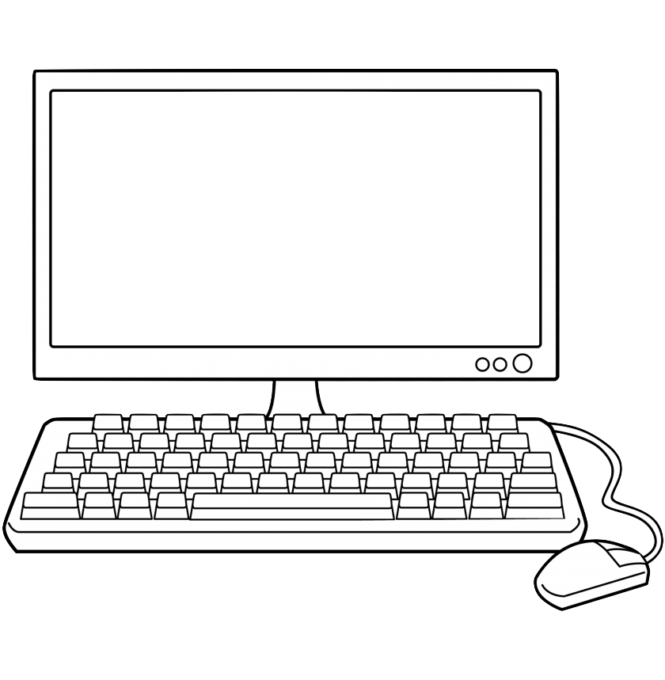
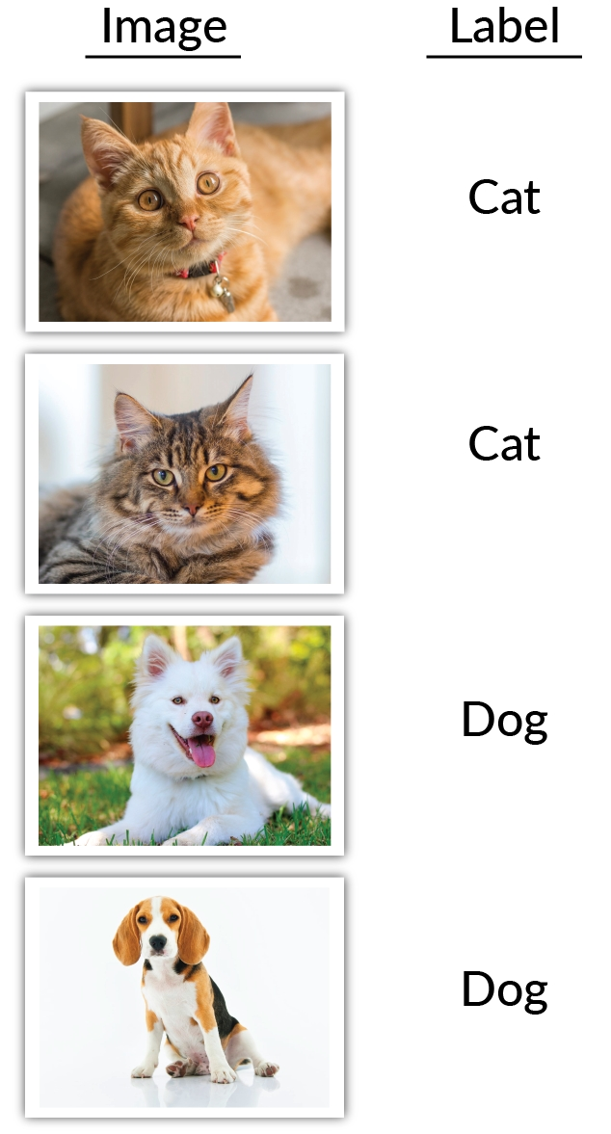
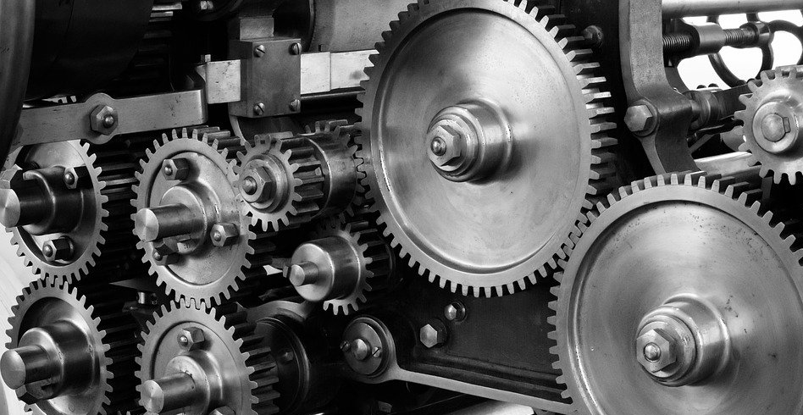
Machine Learning Overview

Slide 4
Machine Learning Overview
supervised
✅
✅

Slide 5
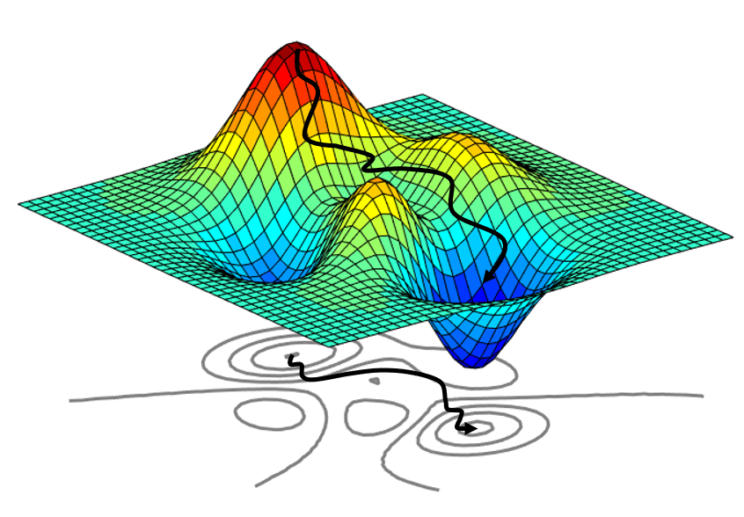
Machine Learning Overview
supervised
✅
✅

Slide 6
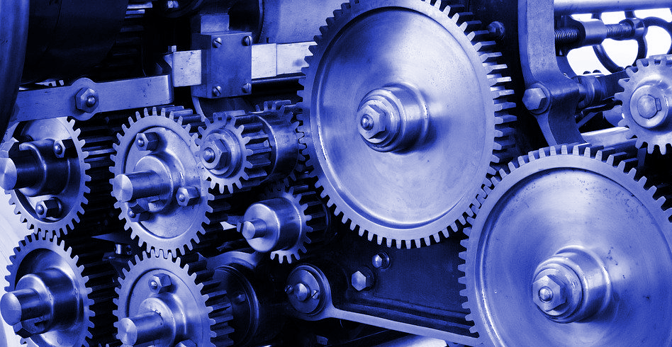
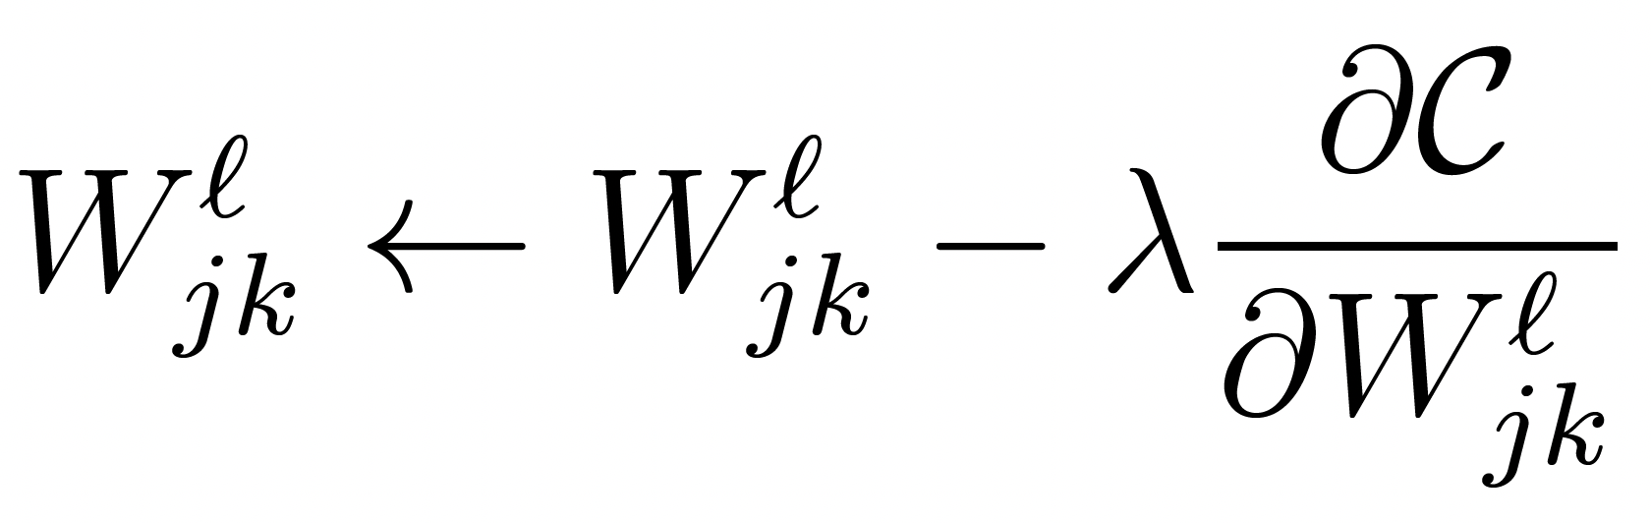
supervised
Machine Learning Overview
✅
✅
✅
✅

Slide 7
unsupervised
animal 1
animal 2
Machine Learning Overview

Slide 8




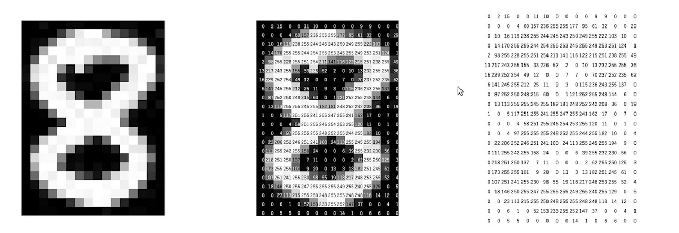
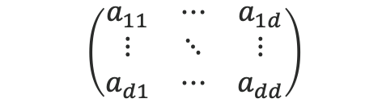

Machine Learning Overview

Slide 9

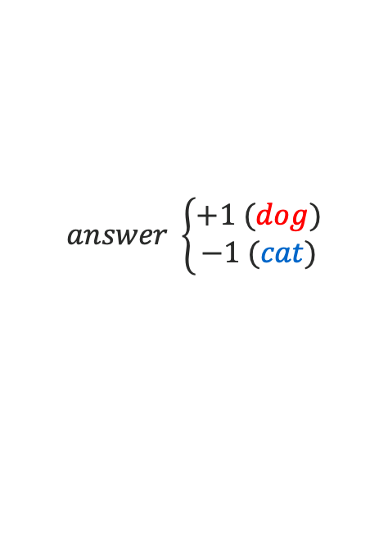
Machine Learning Overview

Slide 10
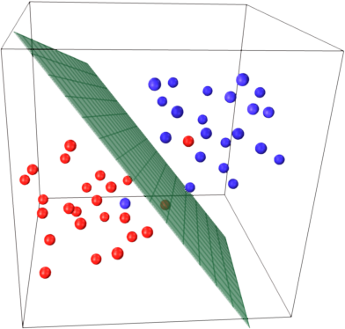
Machine Learning Overview

Slide 11
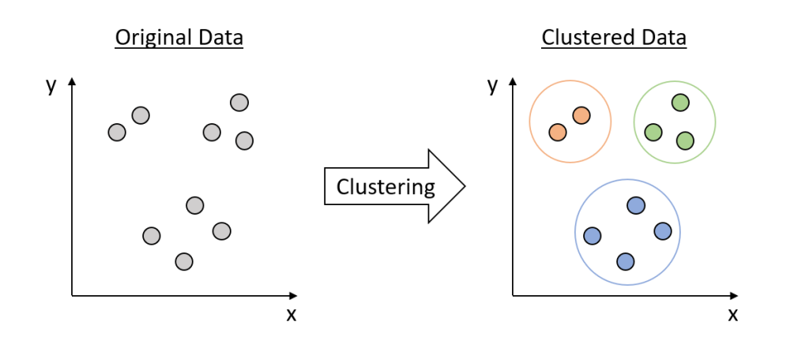
Machine Learning Overview

Slide 12
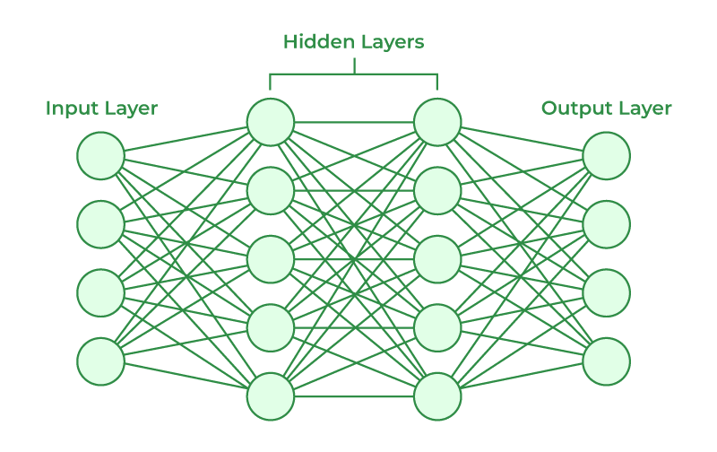


Machine Learning Overview

Slide 13
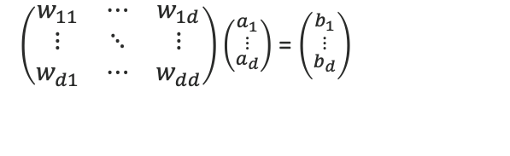





Machine Learning Overview

Slide 14
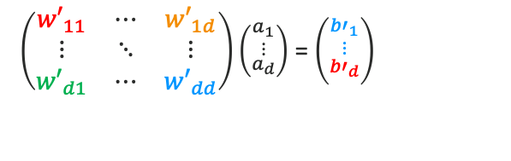





Machine Learning Overview

Slide 15
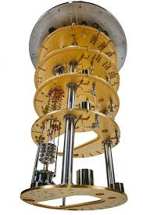
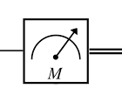

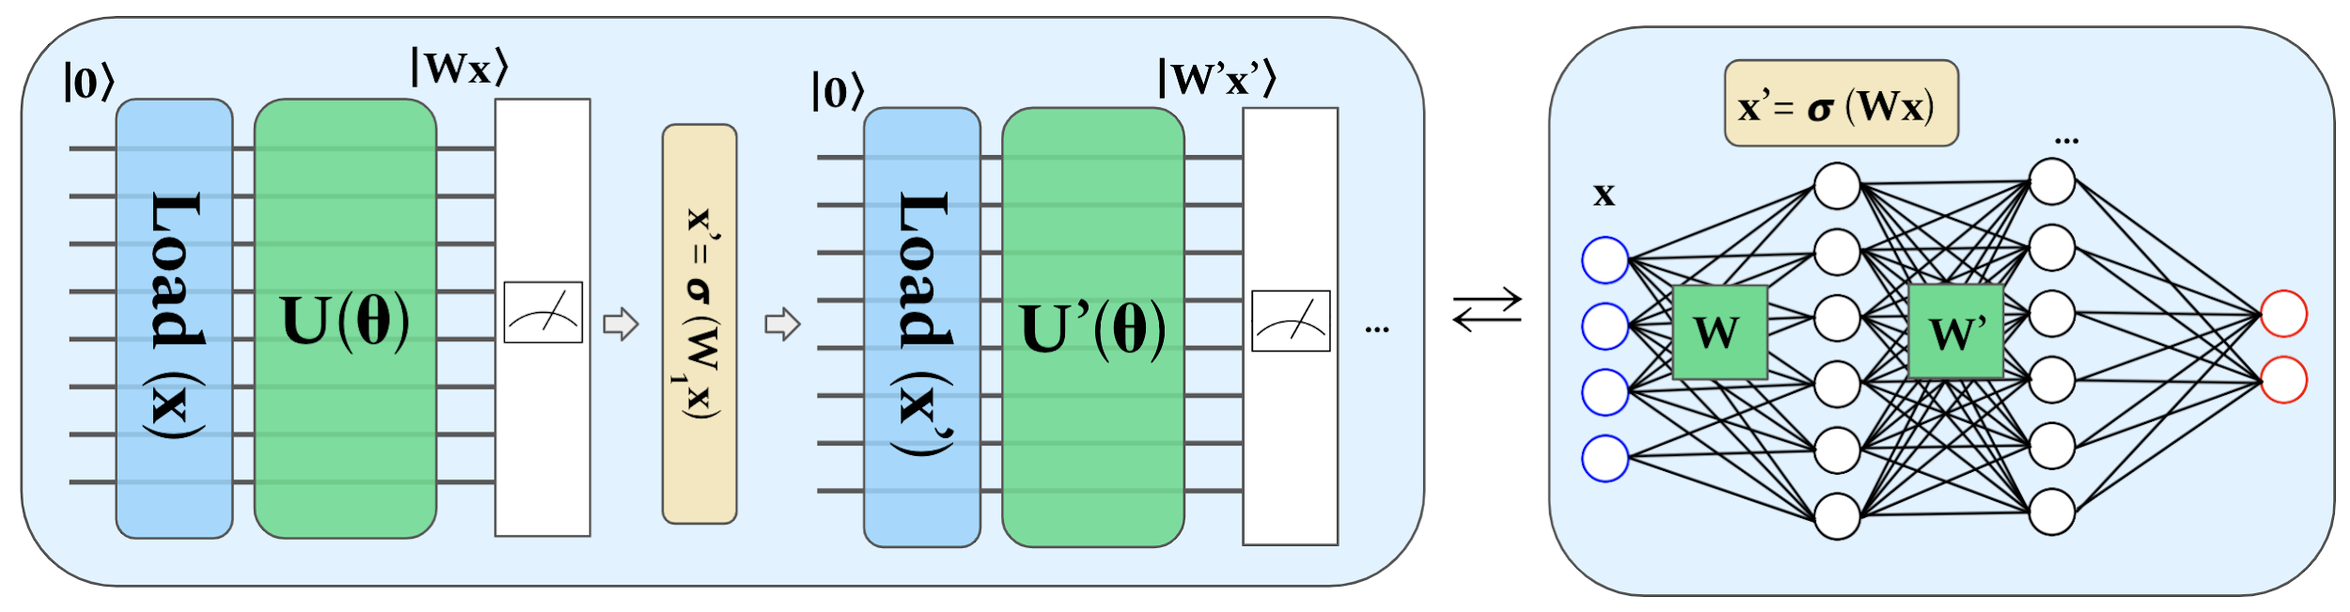
Quantum Machine Learning ?

Slide 16
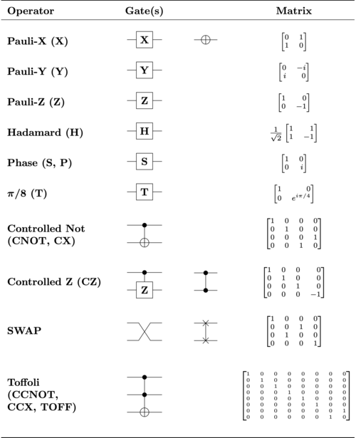


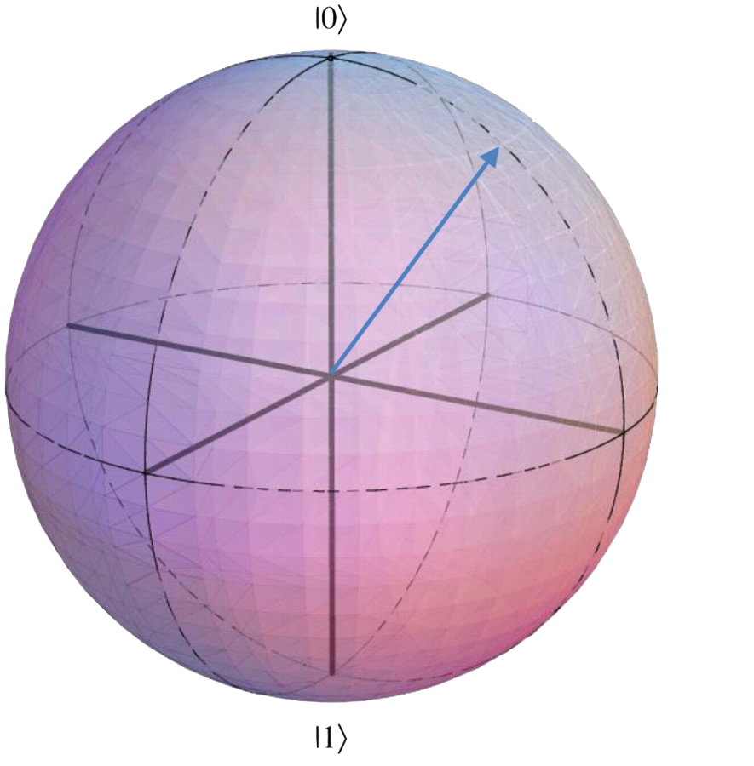
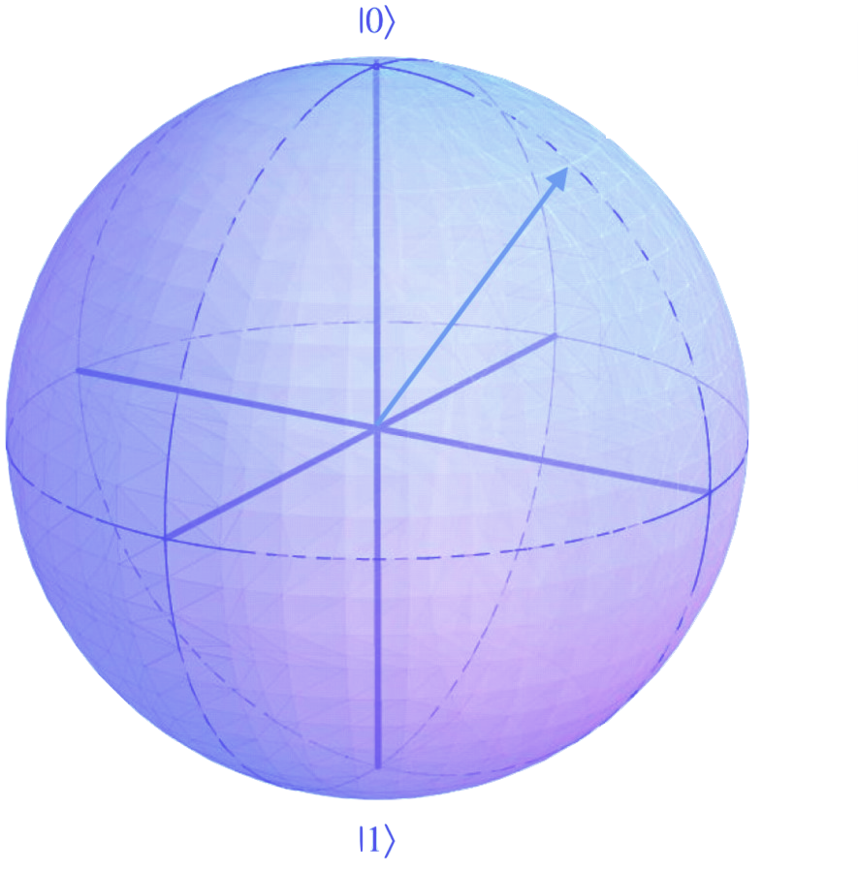
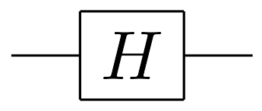


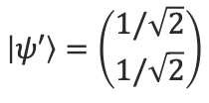
Quantum Information Processing
Logic Gates

Slide 17
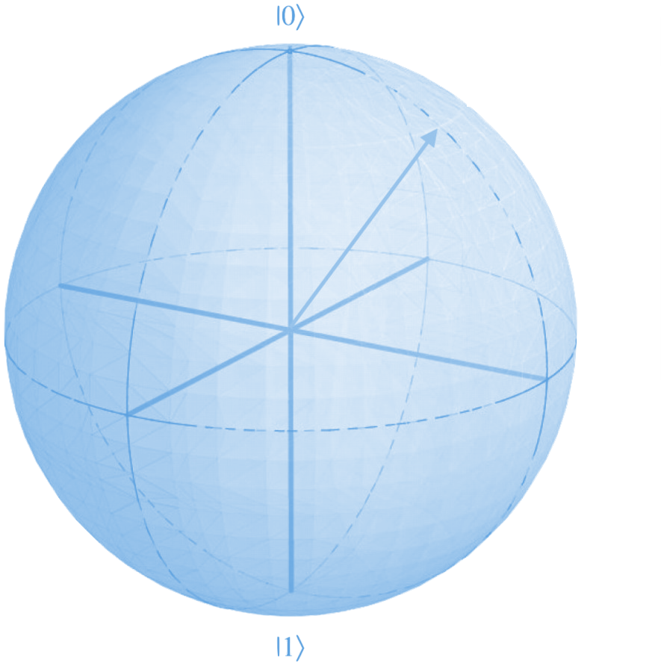

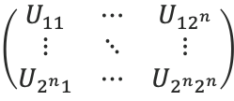




Quantum Information Processing
Logic Gates
U
…

Slide 18

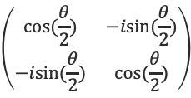


Quantum Information Processing
Logic Gates

Slide 19

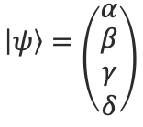
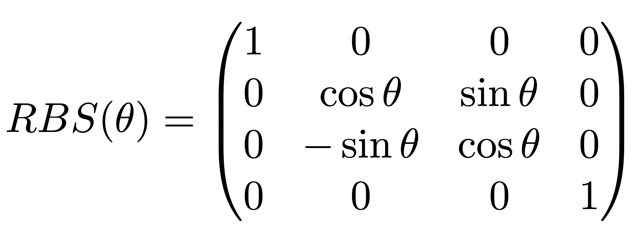
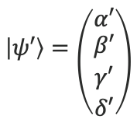
Quantum Information Processing
Logic Gates

Slide 20
Quantum Data Encoding

Slide 21
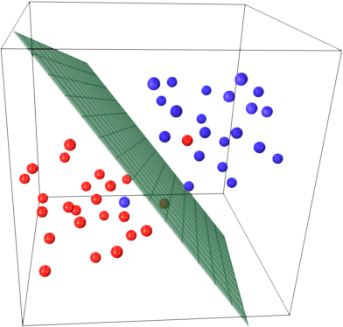

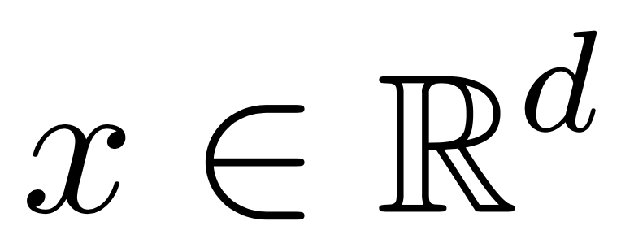
Encoding vectors in quantum states

Slide 22
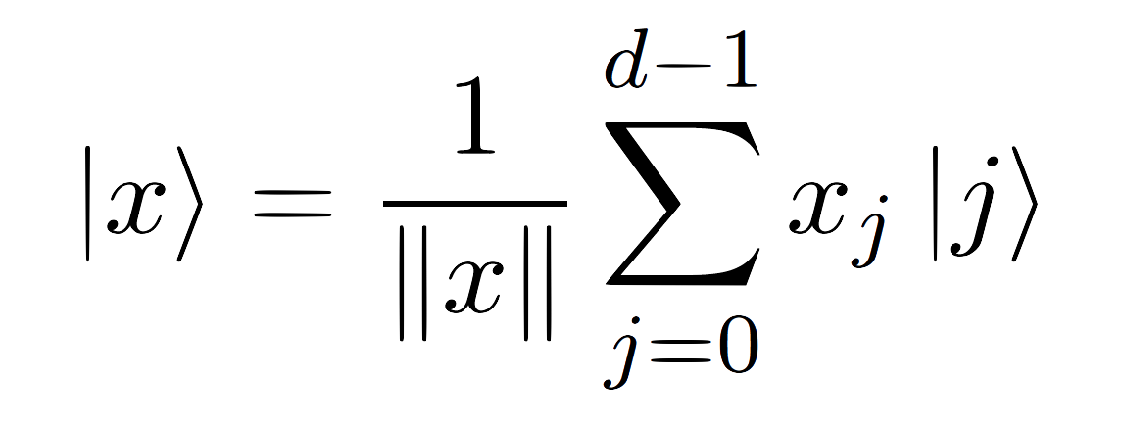




Encoding vectors in quantum states
Amplitude encoding
Long Term
computational basis
qubits
Near Term
unary basis
qubits
? Term
k basis
qubits

Slide 23
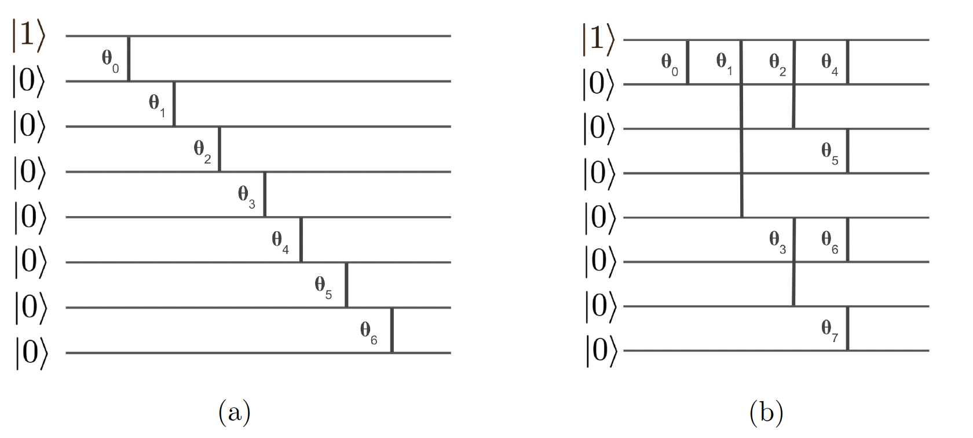
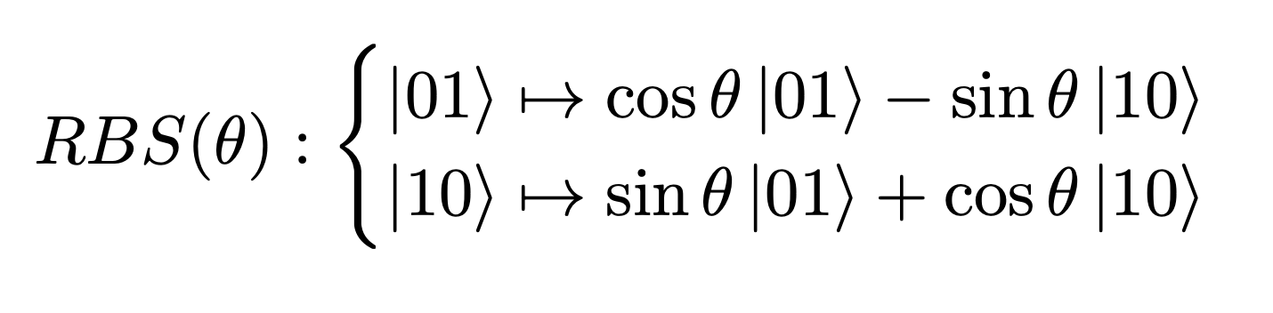
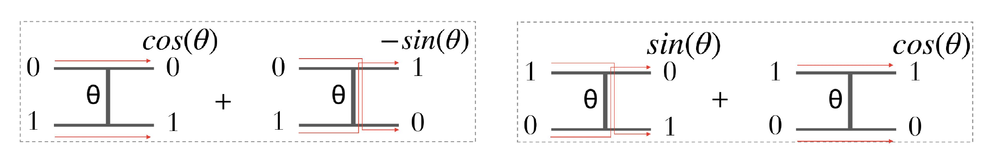
Encoding vectors in quantum states
Near Term
S.Johri et al. “Nearest Centroid Classification on a Trapped Ion Quantum Computer”
Nature pj Quantum Information [2021]

Slide 24
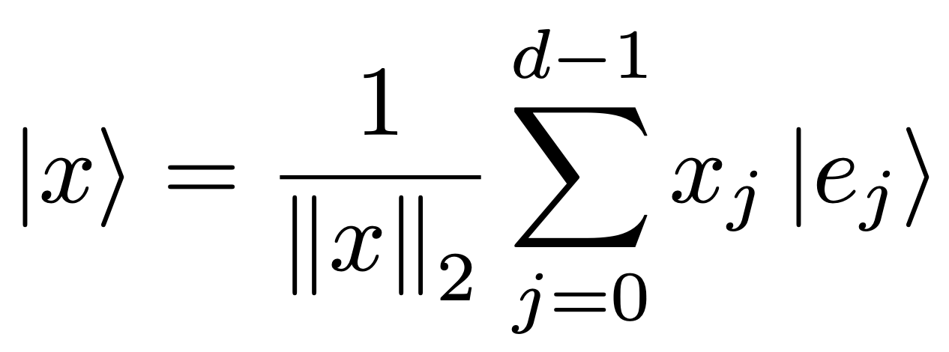
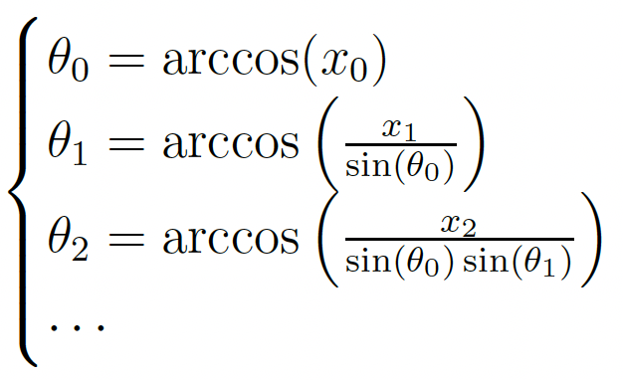
Encoding vectors in quantum states
Near Term
Unary basis
d
d
Diagonal
S.Johri et al. “Nearest Centroid Classification on a Trapped Ion Quantum Computer”
Nature PJ Quantum Information [2021]

Slide 25
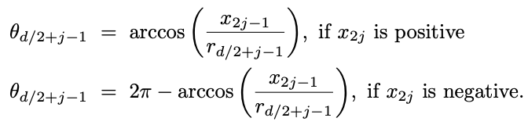



Encoding vectors in quantum states
Near Term
Unary basis
log(d)
Last d/2 values:
d
First d/2 - 1 values:
Parallel
S.Johri et al. “Nearest Centroid Classification on a Trapped Ion Quantum Computer”
Nature PJ Quantum Information [2021]

Slide 26

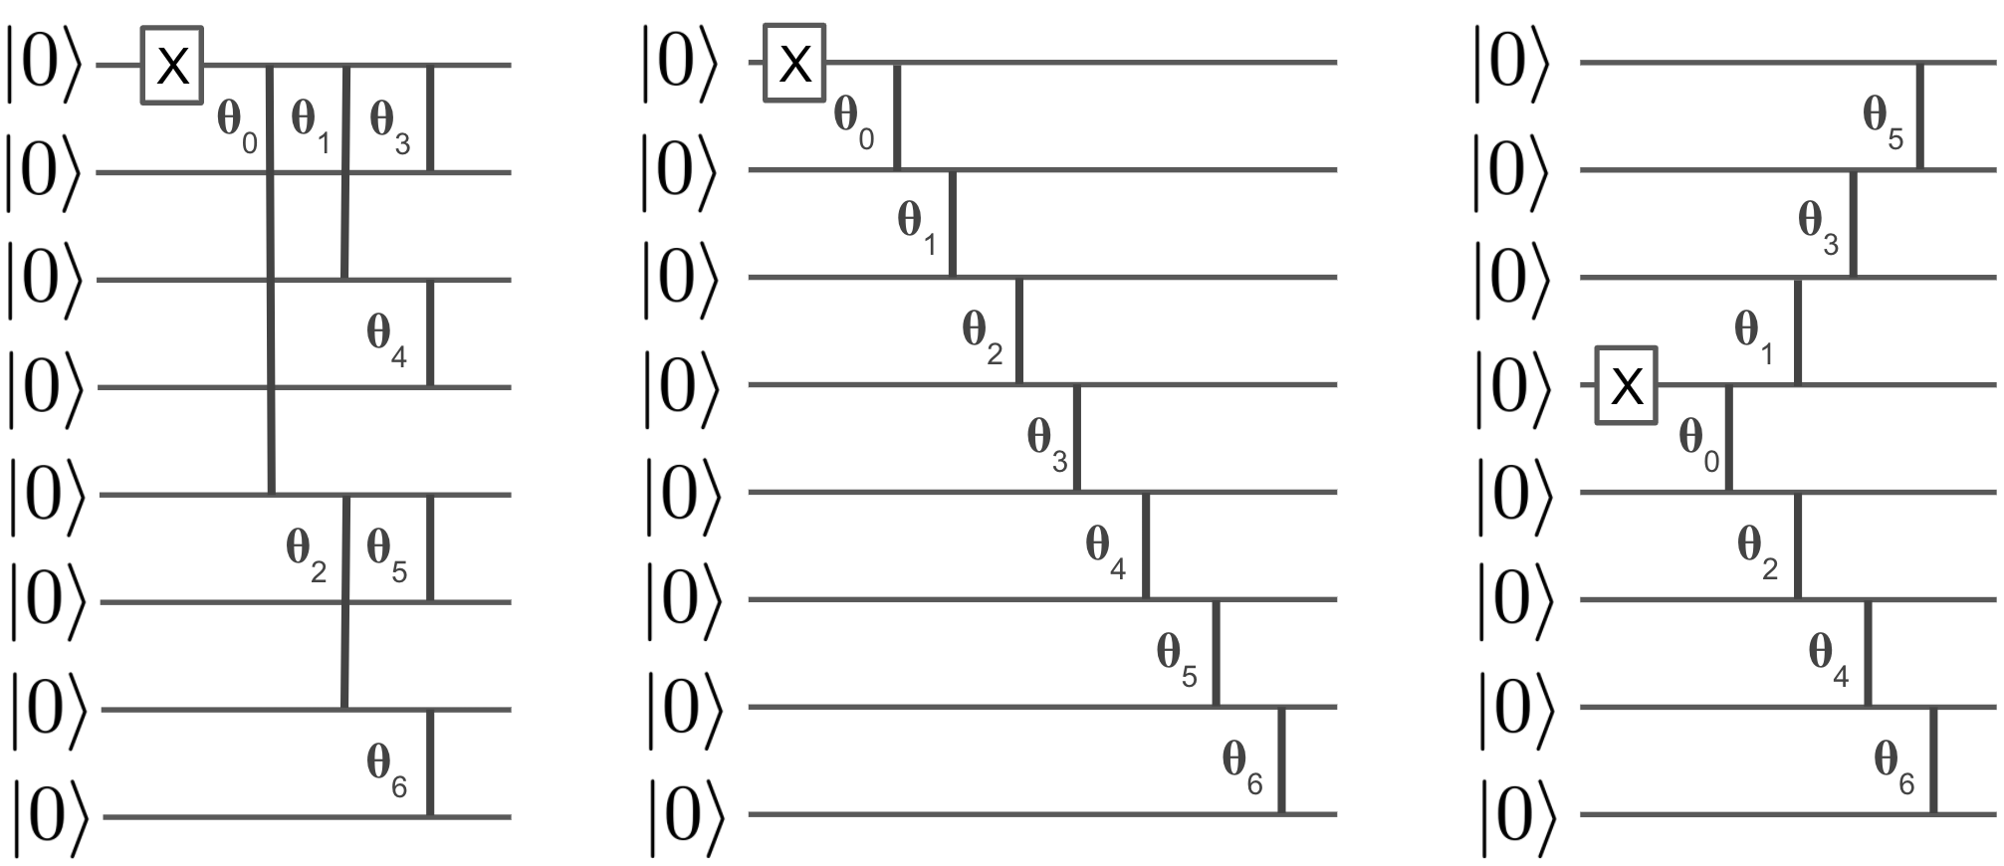
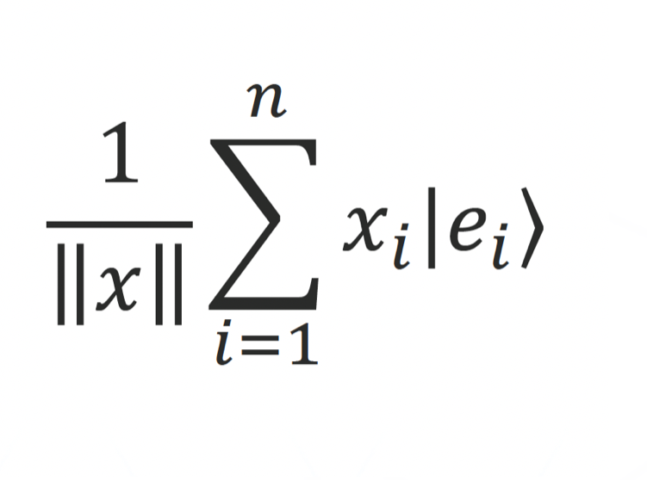

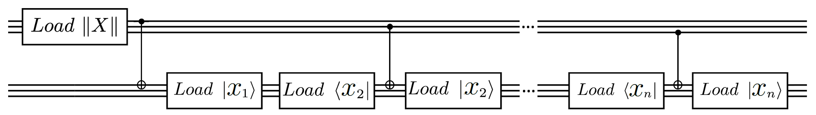
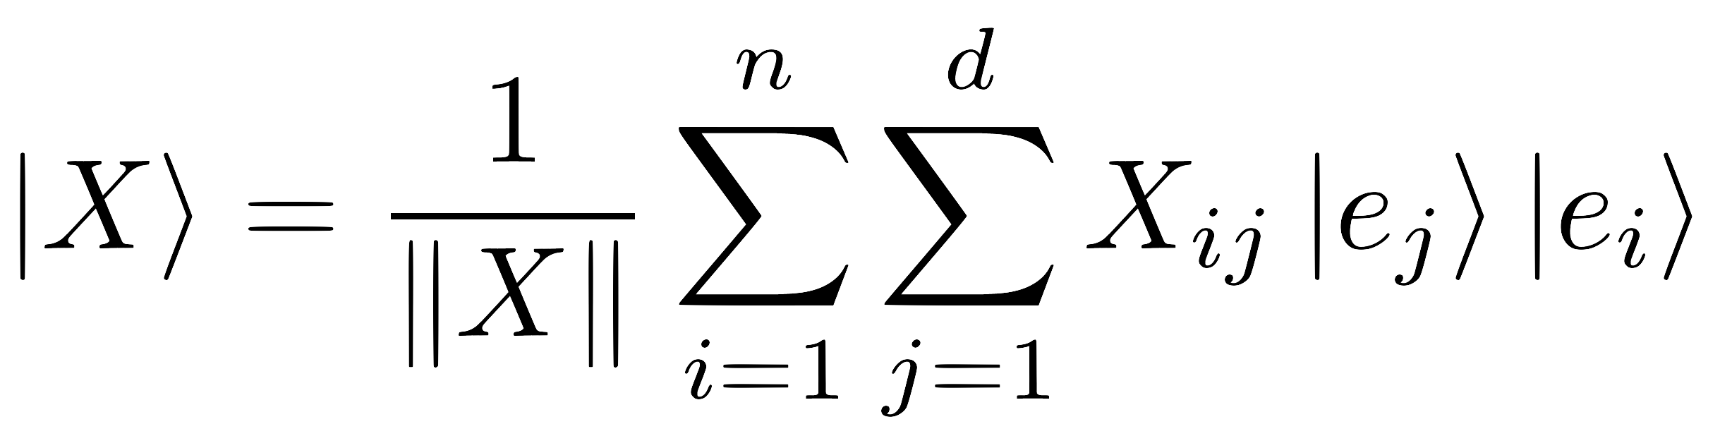
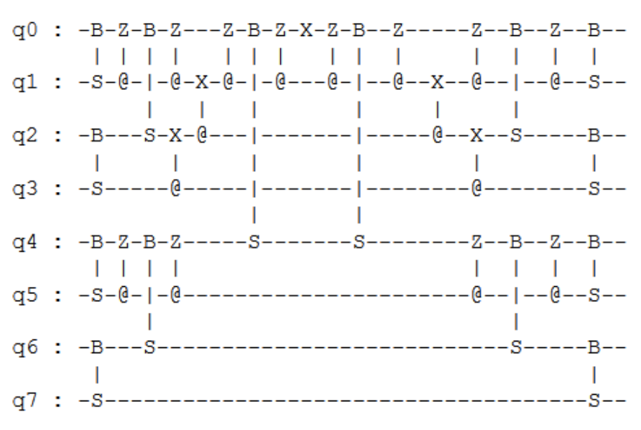
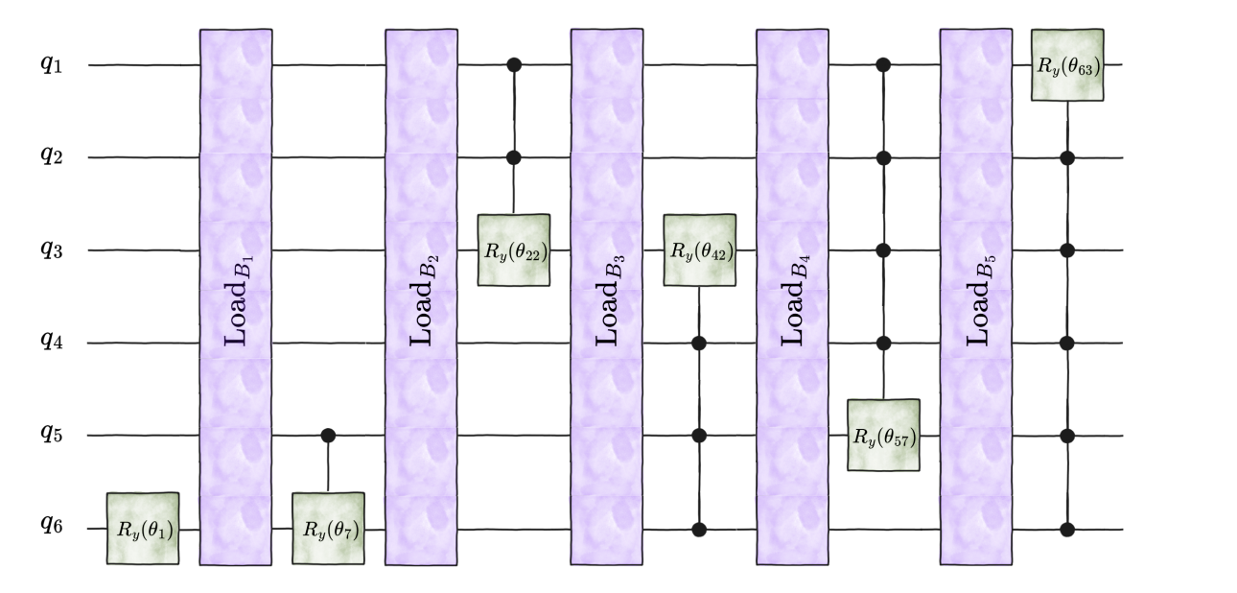

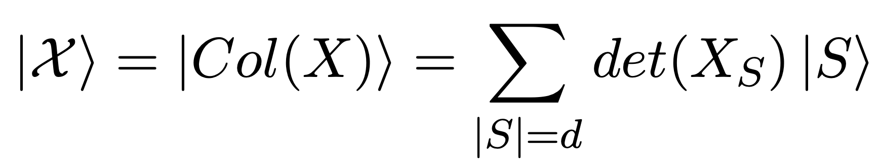
Variety of Quantum Data Loaders
Quantum Vision Transformers EA.Cherrat, I.Kerenidis, N.Mathur, J.Landman, M.Strahm, Y.Li, (2022)
Quantum Machine Learning with Subspace States I.Kerenidis, A.Prakash (2022)
Quantum encoder for fixed Hamming-weight subspaces, Farias et al. (2024)
Unary basis
Two unary basis
Clifford encoding
HW-k encoding

Slide 27
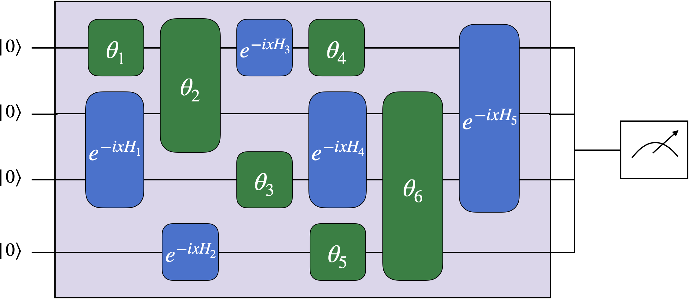
Alternative encoding schemes
Near Term
Phase Encoding
“Supervised quantum machine learning models are kernel methods” M.Schuld

Slide 28
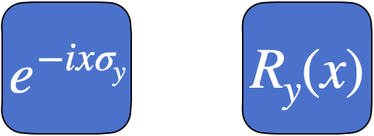
Alternative encoding schemes
Near Term
Phase Encoding
“Supervised quantum machine learning models are kernel methods” M.Schuld

Slide 29
Quantum Neural Networks:
Orthogonal Layer

Slide 30
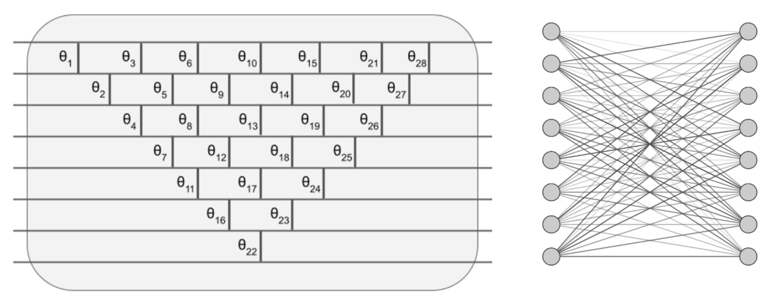
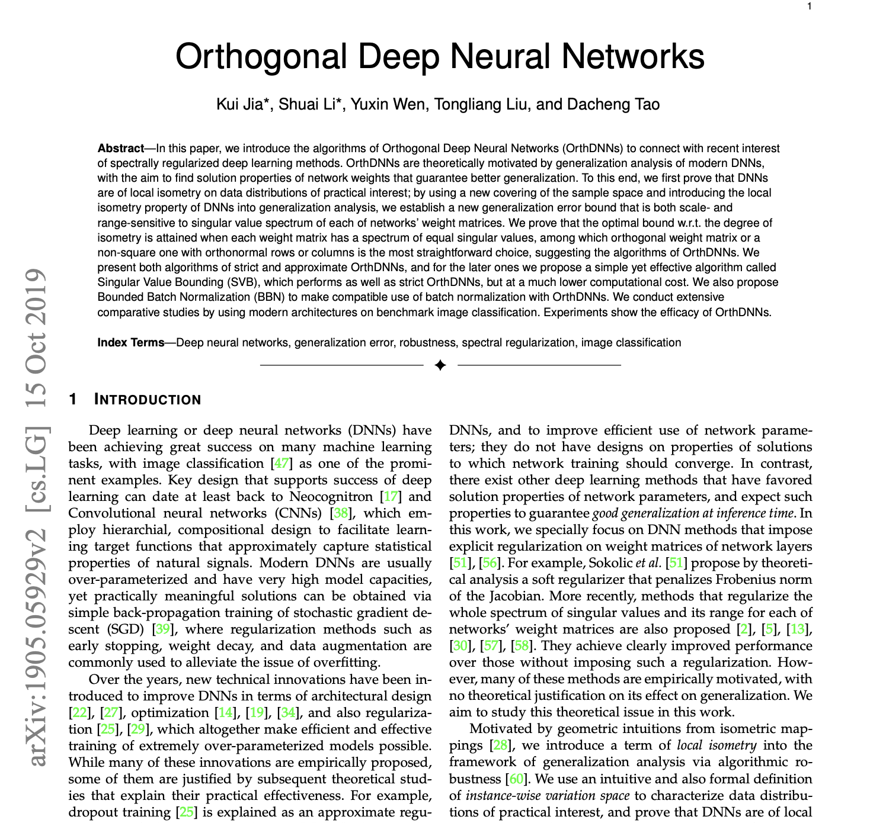
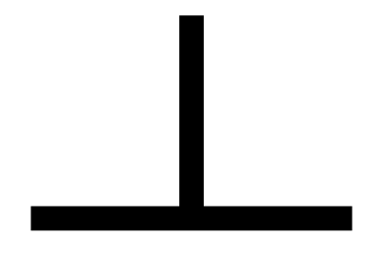
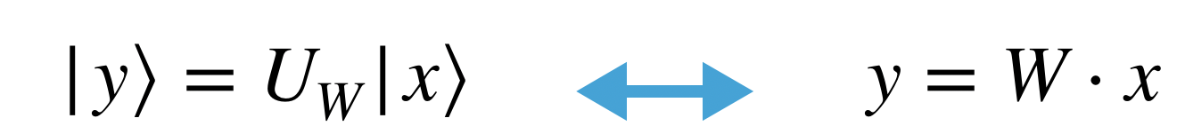
Orthogonal Matrix Multiplication and Neural Networks
Classical and Quantum Algorithms for Orthogonal Neural Networks. Iordanis Kerenidis, JL, Natansh Mathur (2021)
Quantum
Classical
Forward time
O(N)
O(N²)
Number of Gates
N(N+1)/2
N(N+1)/2

Slide 31

Orthogonal Matrix Multiplication and Neural Networks
Classical and Quantum Algorithms for Orthogonal Neural Networks. Iordanis Kerenidis, JL, Natansh Mathur (2021)

Slide 32



Pyramidal Circuits
unary basis

Slide 33

Quantum Neural Networks
Chain layers & (classical) non linearity
+ Custom gradient calculation rule

Slide 34




Variety of Quantum Orthogonal Layers
Quantum Vision Transformers EA.Cherrat, I.Kerenidis, N.Mathur, J.Landman, M.Strahm, Y.Li, (2022)
V
Butterfly
Brick
X
O(N)
O(log N)
O(N)
O(N)

Slide 35
A different optimization landscape

Slide 36


A Hilbert (sub)space Perspective
Properties of Hamming Weight Preserving Quantum Circuits
unary basis

Slide 37




A Hilbert (sub)space Perspective
Properties of Hamming Weight Preserving Quantum Circuits
unary basis
For nearest neighbor connectivity
-Compound

