Slide 1


Quantum
Deep Hedging
Snehal Raj
Joint work with:

Slide 2
Project Outline
Phase Number | Phase Title
A.1 | Use Case Definition
A.2 | Design & Analysis
A.3 | Software Development
A.4 | Simulations
A.5 | Hardware Implementation

Slide 3
Project Overview
A.1 Use Case Definition
Review of classical deep hedging and quantum RL papers Policy search based deep hedging Actor-Critic deep hedging

Slide 4
Project Overview
A.1 Use Case Definition
Review of classical deep hedging and quantum RL papers Policy search based deep hedging Actor-Critic deep hedging
A.2 Design & Analysis
A.2.1 | A.2.2
Design of quantum orthogonal layers. Quantum neural networks for quantum policies. Policy search deep hedging with QNNs | Development of quantum deep hedging using distributional actor-critic. Design of QNNs for quantum policies and quantum value functions.

Slide 5
Project Overview
A.1 Use Case Definition
Review of classical deep hedging and quantum RL papers Policy search based deep hedging Actor-Critic deep hedging
A.2 Design & Analysis
A.2.1 | A.2.2
Design of quantum orthogonal layers. Quantum neural networks for quantum policies. Policy search deep hedging with QNNs | Development of quantum deep hedging using distributional actor-critic. Design of QNNs for quantum policies and quantum value functions.
A.3 Software Development
Implementation of versions of Simple, Recurrent, LSTM, Transformer with Quantum Orthogonal layers Implementation of different RL agents (policy search, actor-critic)

Slide 6
Project Overview
A.1 Use Case Definition
Review of classical deep hedging and quantum RL papers Policy search based deep hedging Actor-Critic deep hedging
A.2 Design & Analysis
A.2.1 | A.2.2
Design of quantum orthogonal layers. Quantum neural networks for quantum policies. Policy search deep hedging with QNNs | Development of quantum deep hedging using distributional actor-critic. Design of QNNs for quantum policies and quantum value functions.
A.3 Software Development
Implementation of versions of Simple, Recurrent, LSTM, Transformer with Quantum Orthogonal layers Implementation of different RL agents (policy search, actor-critic)
A.4 Simulations
Benchmark of deep hedging with QNNs using 16 qubits, for 30 days maturity Benchmark of quantum deep hedging using up to 12 qubits, for 10 days maturity

Slide 7
Project Overview
A.1 Use Case Definition
Review of classical deep hedging and quantum RL papers Policy search based deep hedging Actor-Critic deep hedging
A.2 Design & Analysis
A.2.1 | A.2.2
Design of quantum orthogonal layers. Quantum neural networks for quantum policies. Policy search deep hedging with QNNs | Development of quantum deep hedging using distributional actor-critic. Design of QNNs for quantum policies and quantum value functions.
A.3 Software Development
Implementation of versions of Simple, Recurrent, LSTM, Transformer with Quantum Orthogonal layers Implementation of different RL agents (policy search, actor-critic)
A.4 Simulations
Benchmark of deep hedging with QNNs using 16 qubits, for 30 days maturity Benchmark of quantum deep hedging using up to 12 qubits, for 10 days maturity
A.5 Hardware Implementation
Noisy emulation to optimize hardware implementation Execution of quantum policies on Quantinuum: (i) Deep hedging with QNNs LSTM - 16 qubits (ii) Quantum Deep Hedging QNN - 12 qubits

Slide 8
A.1 Use Case Definition: What is Deep Hedging?
Deep Hedging is a framework for hedging a portfolio of derivatives in the presence of market frictions such as transaction costs using modern deep reinforcement learning methods.

Slide 9
A.1 Use Case Definition: What is Deep Hedging?
Deep Hedging is a framework for hedging a portfolio of derivatives in the presence of market frictions such as transaction costs using modern deep reinforcement learning methods.
Formulation of hedging as a reinforcement learning problem such that:
  The market states contain all current and past prices, cost estimates, news, …
  The trading actions are subject to constraints, such as liquidity limits, risk limits, ...
  The transitions between market states follow the market dynamics.
  The returns include the cash flows and the transaction costs.
  The trading goals maximize the cumulative future returns under some risk-adjusted measure.
environment

Slide 10
A.1 Use Case Definition: What is Deep Hedging?
Deep Hedging is a framework for hedging a portfolio of derivatives in the presence of market frictions such as transaction costs using modern deep reinforcement learning methods.
Formulation of hedging as a reinforcement learning problem such that:
  The market states contain all current and past prices, cost estimates, news, …
  The trading actions are subject to constraints, such as liquidity limits, risk limits, ...
  The transitions between market states follow the market dynamics.
  The returns include the cash flows and the transaction costs.
  The trading goals maximize the cumulative future returns under some risk-adjusted measure.
A Reinforcement Learning algorithm (e.g. policy search) by designing:
  The neural network architectures to model the trading strategy.
  The training loss to find the optimal parameters maximizing the trading goal.
environment

Slide 11
A.2 Design & Analysis
Goal 1: To extend the existing classical framework of deep hedging to use quantum neural networks.

Slide 12
A.2 Design & Analysis
Goal 1: To extend the existing classical framework of deep hedging to use quantum neural networks.
Same formulation of hedging as a reinforcement learning problem
We extended the policy search based RL algorithm to use quantum neural networks to model the trading strategy.

Slide 13
A.2 Design & Analysis
Goal 1: To extend the existing classical framework of deep hedging to use quantum neural networks.
Same formulation of hedging as a reinforcement learning problem
We extended the policy search based RL algorithm to use quantum neural networks to model the trading strategy.
Goal 2: To define a quantum framework for deep hedging using quantum reinforcement learning.

Slide 14
A.2 Design & Analysis
Goal 1: To extend the existing classical framework of deep hedging to use quantum neural networks.
Same formulation of hedging as a reinforcement learning problem
We extended the policy search based RL algorithm to use quantum neural networks to model the trading strategy.
Goal 2: To define a quantum framework for deep hedging using quantum reinforcement learning.
Formulation of hedging as a quantum reinforcement learning problem:
  A quantum environment for deep hedging
  A trading goal in terms of the quantum value function.
A Quantum Reinforcement Learning algorithm (using actor-critic) by designing:
  The quantum circuits to approximate the quantum value function.
  The training loss to learn the expectation/distribution of the quantum value function.

Slide 15
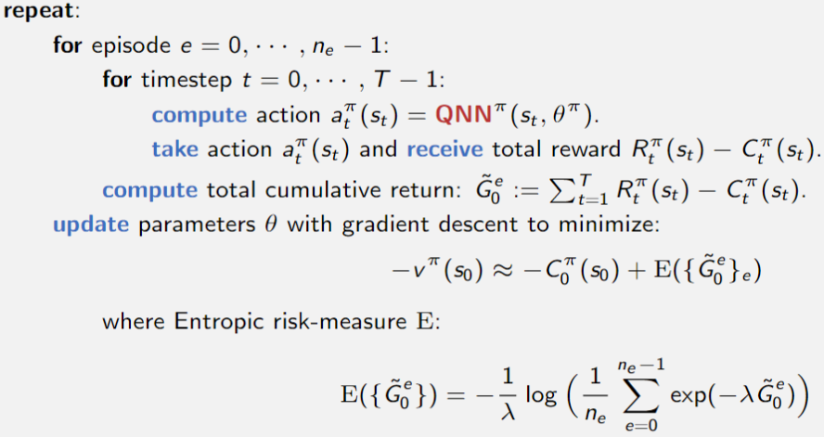
A.2.1 Deep Hedging with Quantum NNs: the algorithm
Policy search-based Deep Hedging Algorithm
Remarks
We use QNNs to model the trading strategy.
We compute the cumulative returns over multiple episodes.
We use gradient descent with an entropic risk-measure to perform policy search.

Slide 16
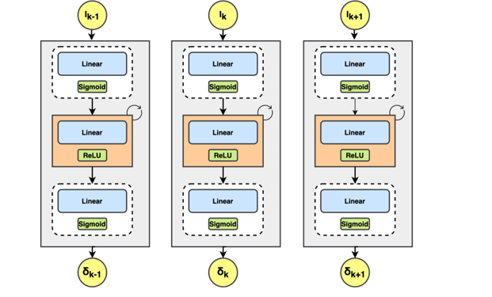

A.2.1 Deep Hedging with Quantum NNs: the quantum NN architectures
Simple

Slide 17
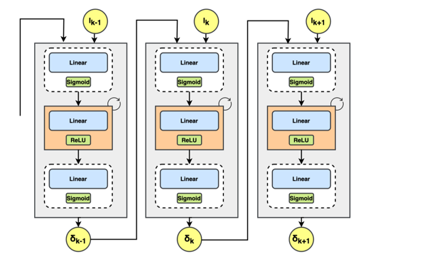

A.2.1 Deep Hedging with Quantum NNs: the quantum NN architectures
Simple
Recurrent

Slide 18
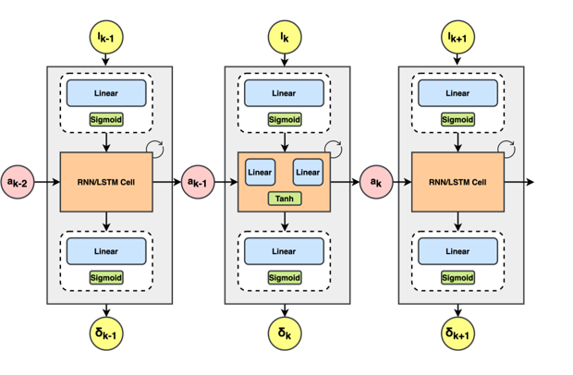

A.2.1 Deep Hedging with Quantum NNs: the quantum NN architectures
Simple
Recurrent
LSTM

Slide 19
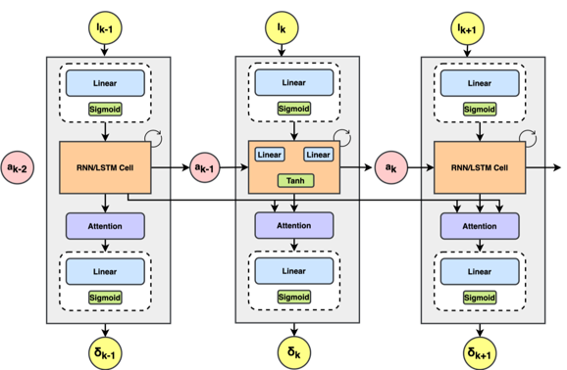
A.2.1 Deep Hedging with Quantum NNs: the quantum NN architectures
Simple
Recurrent
LSTM
Transformer

Slide 20
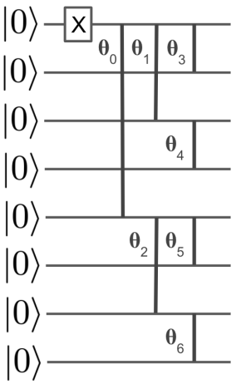
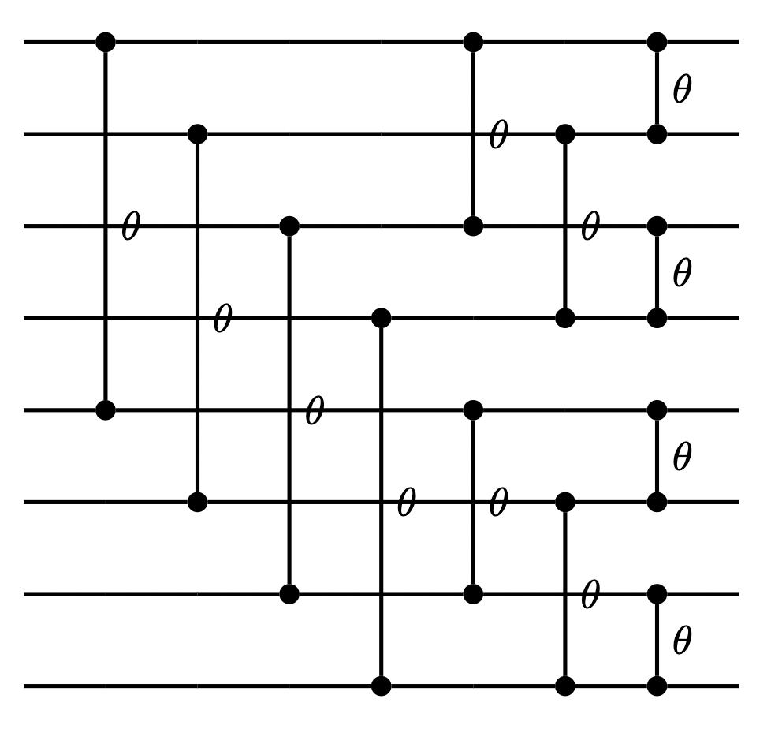
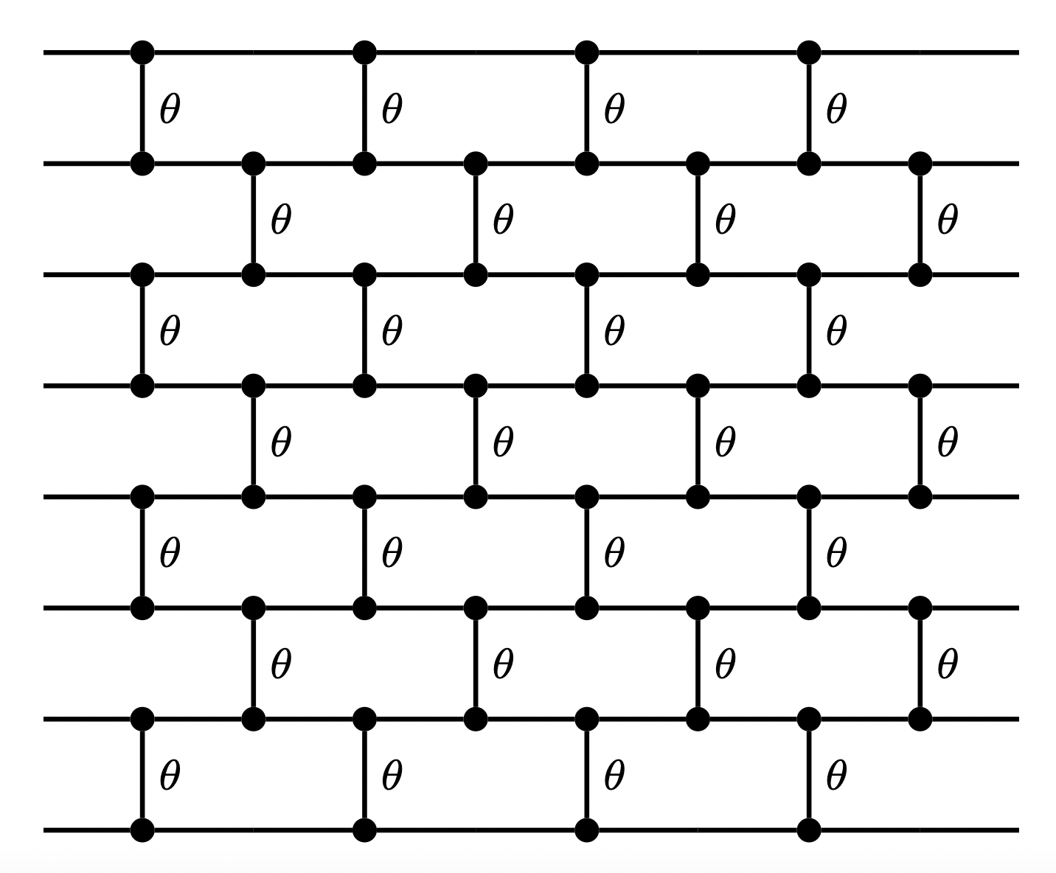
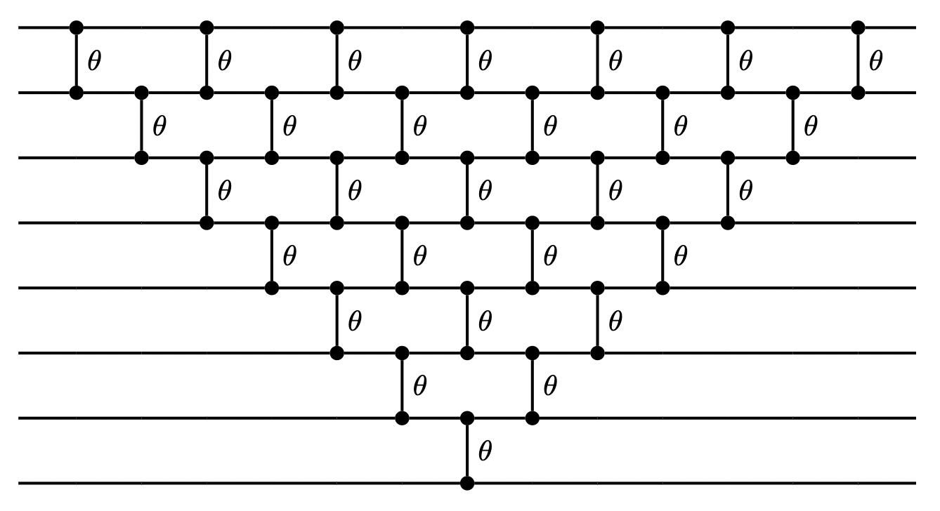
A.2.1 Deep Hedging with Quantum NNs: the quantum layers
Loader
Layer Circuits
Parallel
Butterfly
nlog(n) gates
log(n) depth
n² gates
n depth
Quantum Orthogonal Layers consist of:
An unary amplitude encoding data loader
A parametrized quantum circuit that
Applies a Hamming-weight preserving unitary.
Its action can be described by ^{n}C_{k} x ^{n}C_{k} size compound matrices on hamming weight k inputs.
Mimics forward pass of a fully connected layer while maintaining orthogonality during gradient update.
Brick
log(n) depth
Pyramid
n² gates
n depth

Slide 21
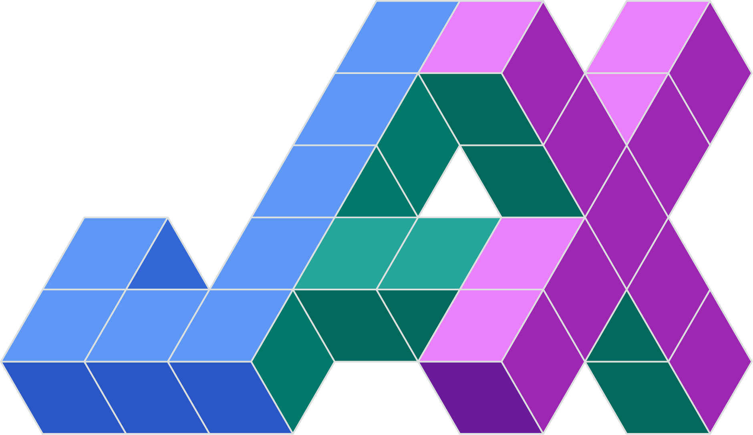
A.3.1 Software Development
Development of a python library for classical/quantum deep hedging:
Framework: JAX
Classical Module:
  [1] Implementation of a classical environment (GBM)
  [1] Implementation of different classical layers
  [1] Implementation of different classical neural networks (Simple, Recurrent, LSTM, Transformer)
Quantum Module:
  [1] Implementation of different quantum orthogonal layers (up to 128 qubits)
  [1] Implementation of different quantum neural networks (up to 128 qubits)
  [2] Implementation of a quantum environment (GBM)
  [2] Implementation of different quantum architectures (up to 12 qubits)
RL Module:
  [1] Implementation of the policy search agent
  [2] Implementation of different actor-critic agents (Expected, Distributional)

Slide 22
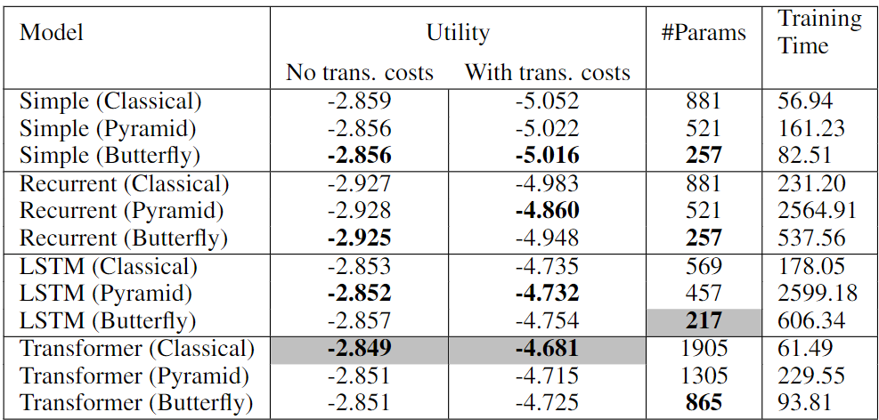
A.4.1 Simulations: Deep Hedging with Quantum NNs
Setting
Environment: Geometric Brownian Motion
  Time horizon: 30 days
  Mu: 0
  Sigma: 0.2
  EPS: 0.0 / 0.01
Model:
  Features/Qubits: 16
  Layers: 3
  Training steps: 100
Inference:
  Backend: JAX Classical Simulator
  Num paths: 256

Slide 23
A.4.1 Simulations: Deep Hedging with Quantum NNs
Remarks
QNNs are competitive with respect to classical NNs
Transformers: more parameters; fast training; competitive performance
LSTM: fewer parameters; long training; competitive performance
Pyramid : fewer parameters than classical, can improve utility
Butterfly circuits strike the best balance between trainable params, training times and model utilities

Slide 24
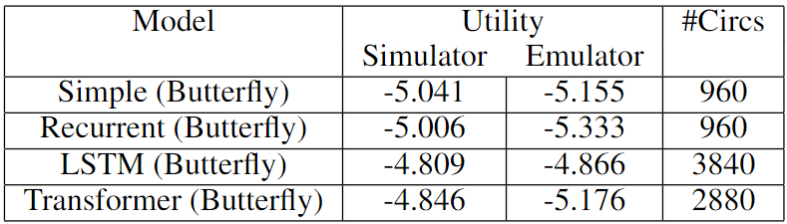
A.5.1 Hardware Implementation: Deep Hedging with Quantum NNs
Setting
Environment: Geometric Brownian Motion
  Time horizon: 30 days
  Mu: 0
  Sigma: 0.2
  EPS: 0.01
Model:
  Features/Qubits: 16
  Layers: 1
  Training steps: 100
Inference:
  Backend: Quantinuum Emulator
  Num measurements: 1000
  Num paths: 32

Slide 25
A.5.1 Hardware Implementation: Deep Hedging with Quantum NNs
Setting
Environment: Geometric Brownian Motion
  Time horizon: 30 days
  Mu: 0
  Sigma: 0.2
  EPS: 0.01
Model:
  Features/Qubits: 16
  Layers: 1
  Training steps: 100
Inference:
  Backend: Quantinuum Emulator
  Num measurements: 1000
  Num paths: 32
Remarks
LSTM with Butterfly layers gives highest utility
LSTM seems to be the most robust to noise

Slide 26
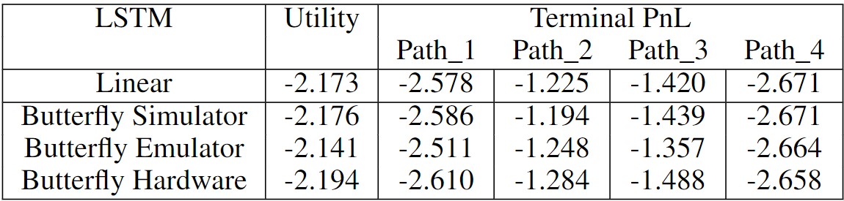
A.5.1 Hardware Implementation: Deep Hedging with Quantum NNs
Setting
Environment: Geometric Brownian Motion
  Time horizon: 5 days
  Mu: 0
  Sigma: 0.2
  EPS: 0.01
Model:
  Features/Qubits: 16
  Layers: 1
  Training steps: 100
Inference:
  Backend: Quantinuum Hardware
  Num measurements: 1000
  Num paths: 4
  Num circuits: 80

Slide 27
A.5.1 Hardware Implementation: Deep Hedging with Quantum NNs
Setting
Environment: Geometric Brownian Motion
  Time horizon: 5 days
  Mu: 0
  Sigma: 0.2
  EPS: 0.01
Model:
  Features/Qubits: 16
  Layers: 1
  Training steps: 100
Inference:
  Backend: Quantinuum Hardware
  Num measurements: 1000
  Num paths: 4
  Num circuits: 80
Remarks
Hardware experiments with 16 qubits succeeded
Utility is close and so are the PnL

Slide 28
A.2.2 Quantum Deep Hedging: the quantum environment
Formulation of deep hedging as a quantum reinforcement learning problem:

Slide 29
A.2.2 Quantum Deep Hedging: the quantum environment
Formulation of deep hedging as a quantum reinforcement learning problem:
  A quantum environment for deep hedging

Slide 30
A.2.2 Quantum Deep Hedging: the quantum environment
Formulation of deep hedging as a quantum reinforcement learning problem:
  A quantum environment for deep hedging
    The market state spaces are discrete.

Slide 31

A.2.2 Quantum Deep Hedging: the quantum environment
Formulation of deep hedging as a quantum reinforcement learning problem:
  A quantum environment for deep hedging
    The market state spaces are discrete.
    The market states are orthogonal to each other:

Slide 32

A.2.2 Quantum Deep Hedging: the quantum environment
Formulation of deep hedging as a quantum reinforcement learning problem:
  A quantum environment for deep hedging
    The market state spaces are discrete.
    The market states are orthogonal to each other:
    The next market states can be decomposed as:

Slide 33
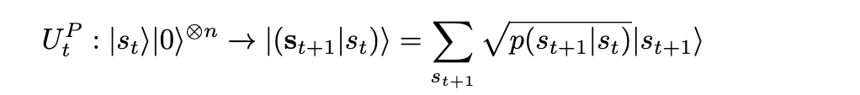
A.2.2 Quantum Deep Hedging: the quantum environment
Formulation of deep hedging as a quantum reinforcement learning problem:
  A quantum environment for deep hedging
    The market state spaces are discrete.
    The market states are orthogonal to each other:
    The next market states can be decomposed as:
    We define quantum oracles that describe the transition probabilities:

Slide 34
A.2.2 Quantum Deep Hedging: the quantum environment
Formulation of deep hedging as a quantum reinforcement learning problem:
  A quantum environment for deep hedging
    The market state spaces are discrete.
    The market states are orthogonal to each other:
    The next market states can be decomposed as:
    We define quantum oracles that describe the transition probabilities:
  A trading goal in terms of the quantum value function.

Slide 35

A.2.2 Quantum Deep Hedging: the quantum environment
Formulation of deep hedging as a quantum reinforcement learning problem:
  A quantum environment for deep hedging
    The market state spaces are discrete.
    The market states are orthogonal to each other:
    The next market states can be decomposed as:
    We define quantum oracles that describe the transition probabilities:
  A trading goal in terms of the quantum value function.
    We show that there exist observables that match exactly the quantum value function:

Slide 36


A.2.2 Quantum Deep Hedging: the quantum environment
Formulation of deep hedging as a quantum reinforcement learning problem:
  A quantum environment for deep hedging
    The market state spaces are discrete.
    The market states are orthogonal to each other:
    The next market states can be decomposed as:
    We define quantum oracles that describe the transition probabilities:
  A trading goal in terms of the quantum value function.
    We show that there exist observables that match exactly the quantum value function:
    We redefine the trading goal for quantum deep hedging:

Slide 37
A.2.2 Quantum Deep Hedging: the quantum neural network architecture
A Quantum Reinforcement Learning algorithm (using actor-critic) by designing:

Slide 38
A.2.2 Quantum Deep Hedging: the quantum neural network architecture
A Quantum Reinforcement Learning algorithm (using actor-critic) by designing:
  The quantum circuits to approximate the quantum value function.

Slide 39

A.2.2 Quantum Deep Hedging: the quantum neural network architecture
A Quantum Reinforcement Learning algorithm (using actor-critic) by designing:
  The quantum circuits to approximate the quantum value function.
    We show there exist quantum circuits that approximate the observables

Slide 40
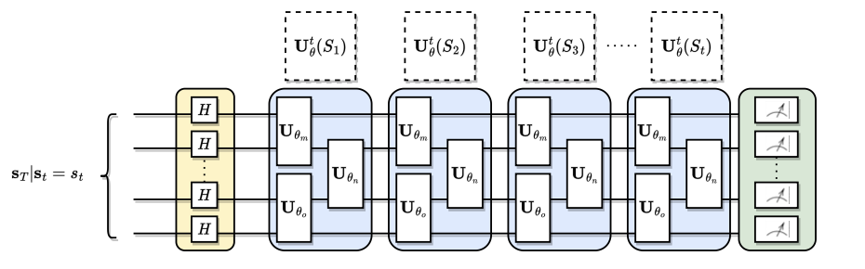
A.2.2 Quantum Deep Hedging: the quantum neural network architecture
A Quantum Reinforcement Learning algorithm (using actor-critic) by designing:
  The quantum circuits to approximate the quantum value function.
    We show there exist quantum circuits that approximate the observables
    We design Hamming-weight preserving quantum circuits to learn these observables

Slide 41
A.2.2 Quantum Deep Hedging: the quantum neural network architecture
A Quantum Reinforcement Learning algorithm (using actor-critic) by designing:
  The quantum circuits to approximate the quantum value function.
    We show there exist quantum circuits that approximate the observables
    We design Hamming-weight preserving quantum circuits to learn these observables
  The training loss to learn the expectation/distribution of the quantum value function.
Expected:
Distributional:

Slide 42
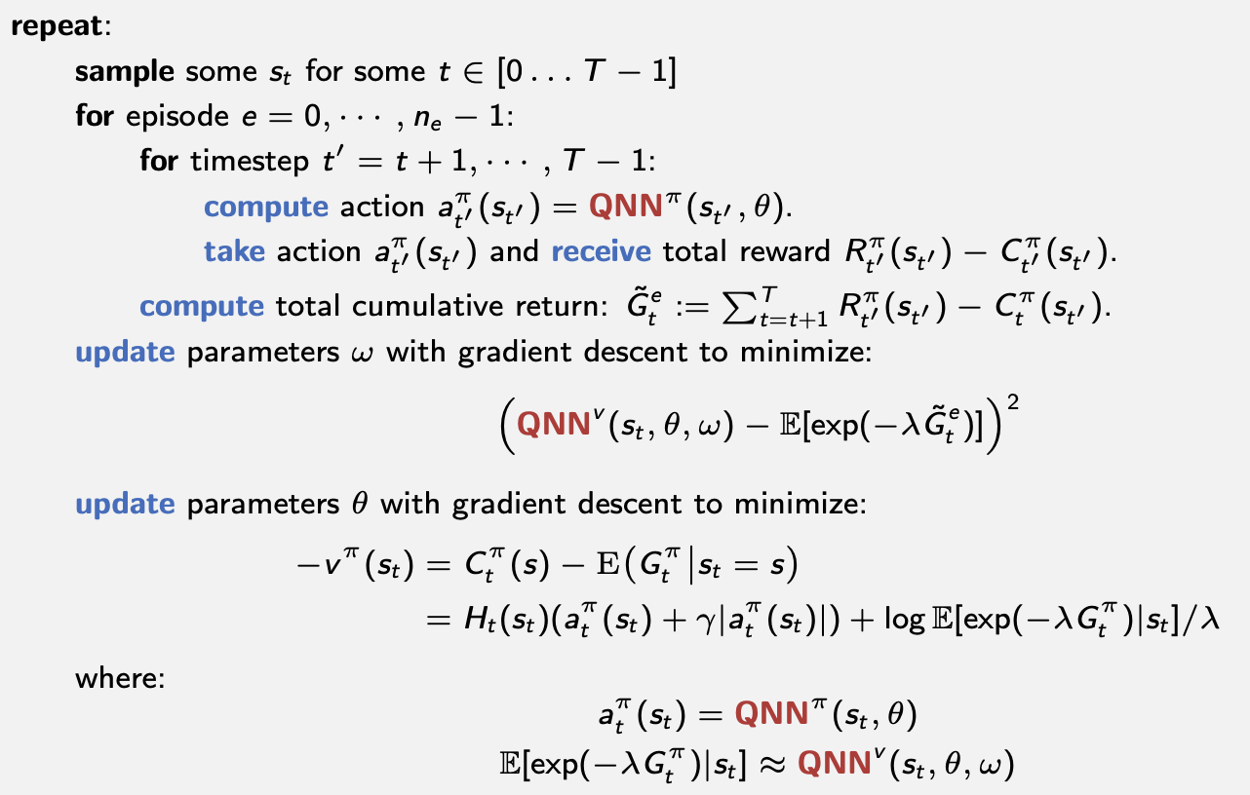
A.2.2 Quantum Deep Hedging: the algorithms
Expected Actor-Critic
Critic loss:
L2 loss for learning the expectation.
Actor loss:
We have tried different actor losses: REINFORCE, Policy Gradient, Actor-Critic Deep Hedging.

Slide 43
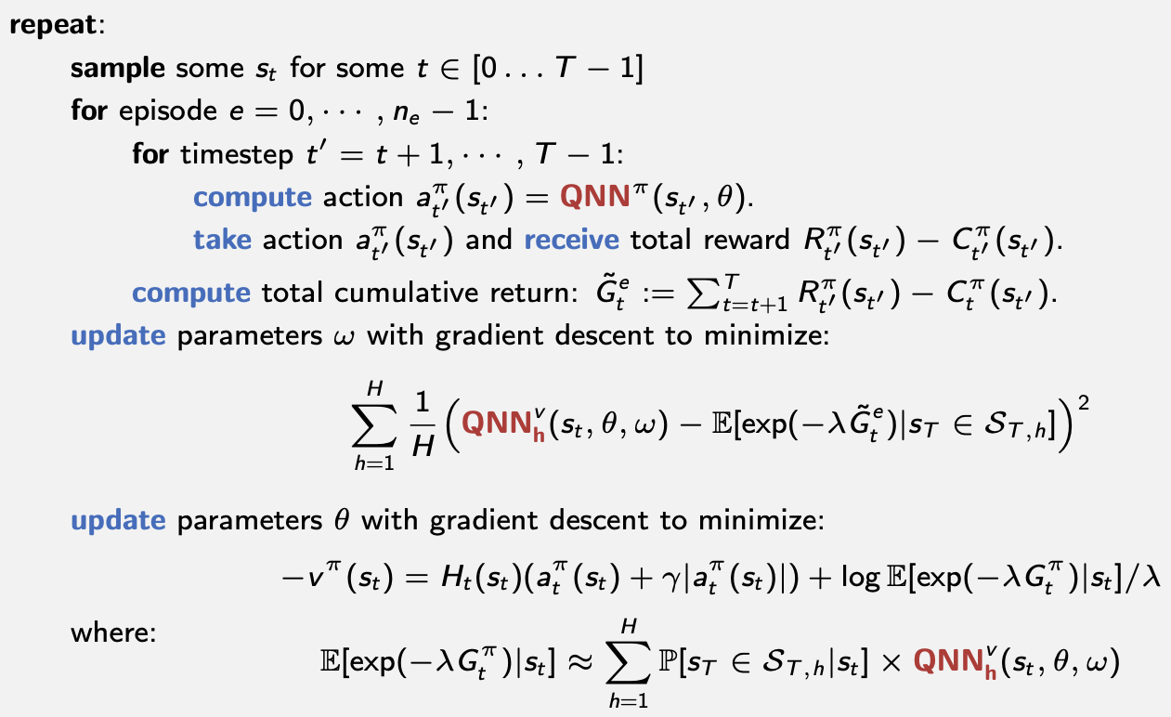
A.2.2 Quantum Deep Hedging: the algorithms
Distributional Actor-Critic
Critic loss:
L2 loss for learning an expectation per subspace.
Actor loss:
We have tried different actor losses: REINFORCE, Policy Gradient, Actor-Critic Deep Hedging.

Slide 44
A.3.2 Software Development
Development of a python library for classical/quantum deep hedging:
Framework: JAX
Classical Module:
  [1] Implementation of a classical environment (GBM)
  [1] Implementation of different classical layers
  [1] Implementation of different classical neural networks (Simple, Recurrent, LSTM, Transformer)
Quantum Module:
  [1] Implementation of different quantum orthogonal layers (up to 128 qubits)
  [1] Implementation of different quantum neural networks (up to 128 qubits)
  [2] Implementation of a quantum environment (GBM)
  [2] Implementation of different quantum architectures (up to 12 qubits)
RL Module:
  [1] Implementation of the policy search agent
  [2] Implementation of different actor-critic agents (Expected, Distributional)

Slide 45
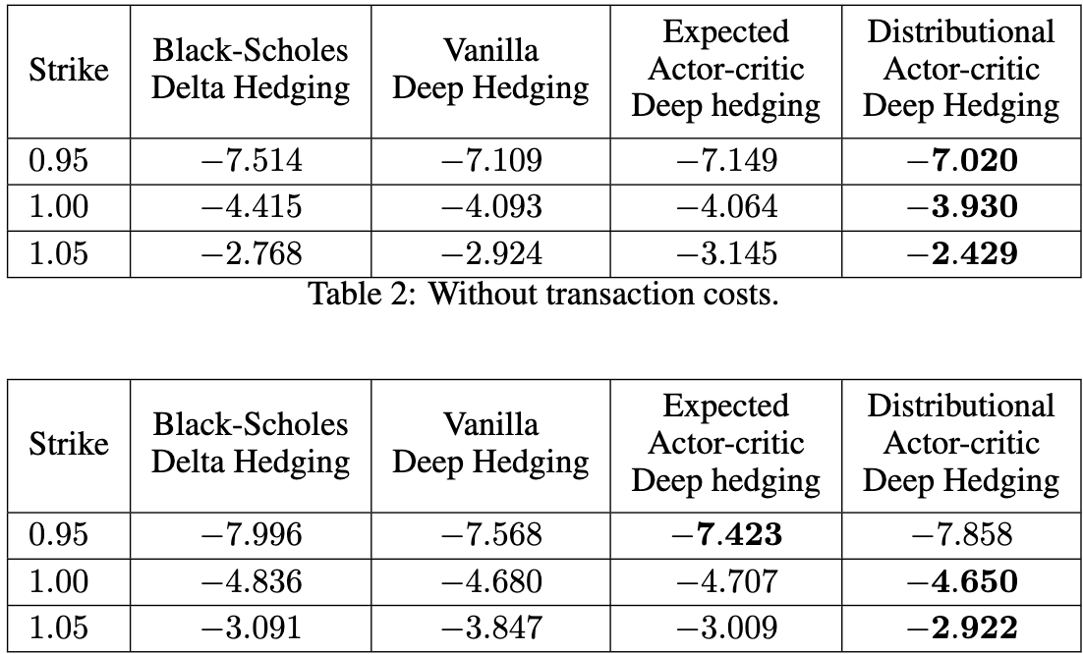
A.4.2 Simulations: Quantum Deep Hedging
Setting
Environment: Geometric Brownian Motion
  Time horizon: 10 days
  T’: 30
  Mu: 0
  Sigma: 0.2
  EPS: 0.002
Layout:
  Bricks of logarithmic depth
  Qubits: up to 12
Training steps: 5000
Inference:
  Backend: JAX Classical Simulator
  Num paths: 16
Without
transaction costs
With
transaction costs

Slide 46
A.4.2 Simulations: Quantum Deep Hedging
Setting
Environment: Geometric Brownian Motion
  Time horizon: 10 days
  T’: 30
  Mu: 0
  Sigma: 0.2
  EPS: 0.002
Layout:
  Bricks of logarithmic depth
  Qubits: up to 12
Training steps: 5000
Inference:
  Backend: JAX Classical Simulator
  Num paths: 16
Without
transaction costs
With
transaction costs
Remarks:
Distributional Actor-Critic can provide better models in most scenarios.
Similar conclusion than classical analysis by Lyle et al. (2019).

Slide 47
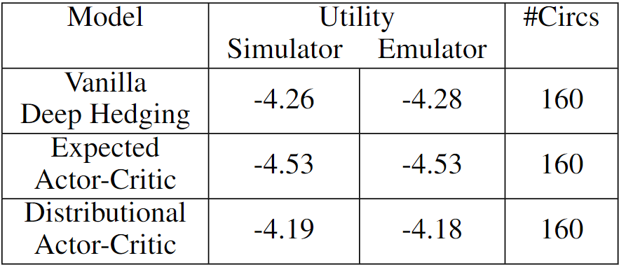
A.5.2 Hardware Implementation: Quantum Deep Hedging
Setting
Environment: Geometric Brownian Motion
  Time horizon: 10 days
  T’: 30
  Mu: 0
  Sigma: 0.2
  EPS: 0.002
Layout:
  Bricks of constant depth
  Qubits: up to 12
Training steps: 5000
Inference:
  Backend: Quantinuum Emulator
  Num paths: 16
  Num measurements: 1000

Slide 48
A.5.2 Hardware Implementation: Quantum Deep Hedging
Setting
Environment: Geometric Brownian Motion
  Time horizon: 10 days
  T’: 30
  Mu: 0
  Sigma: 0.2
  EPS: 0.002
Layout:
  Bricks of constant depth
  Qubits: up to 12
Training steps: 5000
Inference:
  Backend: Quantinuum Emulator
  Num paths: 16
  Num measurements: 1000
Results:
Distributional Actor-Critic provides the best model
All models are resilient to noise

Slide 49
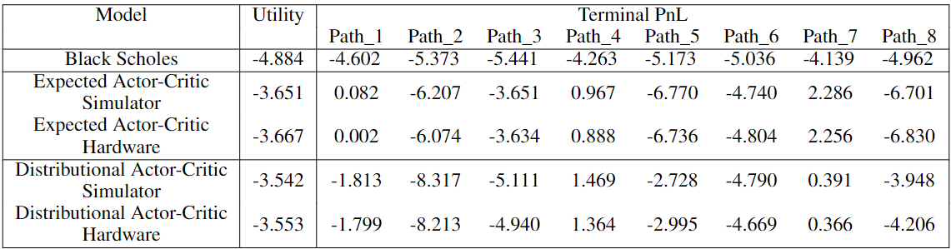
A.5.2 Hardware Implementation: Quantum Deep Hedging
Setting
Environment: Geometric Brownian Motion
  Time horizon: 10 days
  T’: 30
  Mu: 0
  Sigma: 0.2
  EPS: 0.002
Layout:
  Bricks of constant depth
  Qubits: up to 12
Training steps: 5000
Inference:
  Backend: Quantinuum Hardware
  Num paths: 8
  Num measurements: 1000

Slide 50
A.5.2 Hardware Implementation: Quantum Deep Hedging
Setting
Environment: Geometric Brownian Motion
  Time horizon: 10 days
  T’: 30
  Mu: 0
  Sigma: 0.2
  EPS: 0.002
Layout:
  Bricks of constant depth
  Qubits: up to 12
Training steps: 5000
Inference:
  Backend: Quantinuum Hardware
  Num paths: 8
  Num measurements: 1000
Remarks:
Hardware experiments with up to 12 qubits succeeded
Utility is close and so are the PnL

Slide 51
Main conclusion
Quantum Deep Hedging is a powerful alternative to Classical Deep Hedging
  Deep Hedging with Quantum Neural Networks
    train efficiently with no vanishing gradients.
    offer comparable (at times better) performance.
    can offer computational speed-ups in the future.
    can be implemented on NISQ hardware
  Quantum Deep Hedging
    Quantum Value Functions efficiently learn the returns’ expectation/distribution.
    Quantum Distributional Actor-Critic offers better performance than Vanilla and Expected
    Quantum Policies can be trained to be qualitatively different than Black-Scholes

Slide 52
Future steps - Open questions
Can QNNs improve interpretability of the models (orthogonality) or reduce parameters?
Quantum Deep Hedging
  How do we train in a model-free setting?
  Can we prove the gradients do not vanish in our quantum neural network?
  How do we generalize the quantum environment model to more realistic settings ?
  How do we find losses for learning distributions in the quantum case? (Renyi, Wasserstein)
Can we use quantum RL for other Finance use cases, e.g. trading?

Slide 53
Thank you!
Snehal Raj

Slide 54
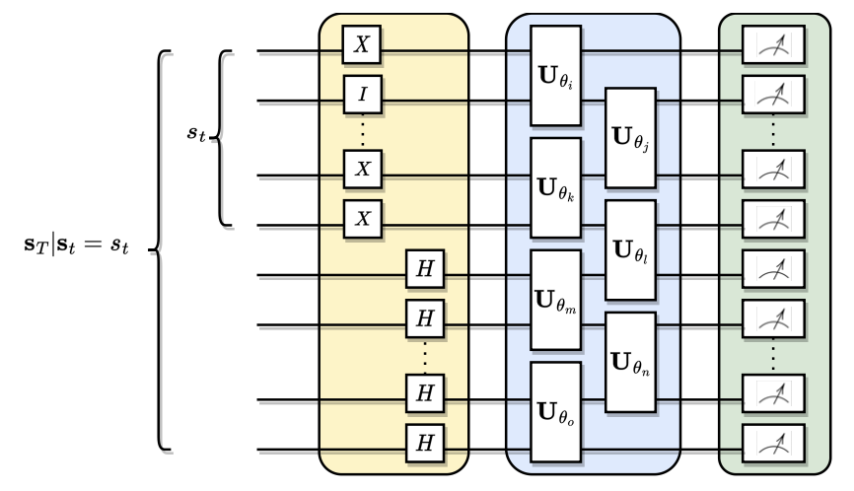
Appendix: Quantum Deep Hedging: Circuits that we tried
(bricks of depth log(T-t) per
classical control)
Depth | O(T) | O(tlog(T-t))
Number of qubits | O(T) | O(T-t)
Number of parameters | O(T²) | Õ(t(T-t))
Total number of parameters | O(T³) | O(T³)
Convergence issues with first architecture
Better performance with second architecture

