Slide 1

QUANTUM COMPUTING SYSTEMS:
A SOFTWARE, ARCHITECTURE, and
Systems PERSPECTIVE -I
Why quantum computing? What topics will be covered? What are the requirements and expected outcomes?
POULAMI DAS
ECE, The University of Texas at Austin

Slide 2

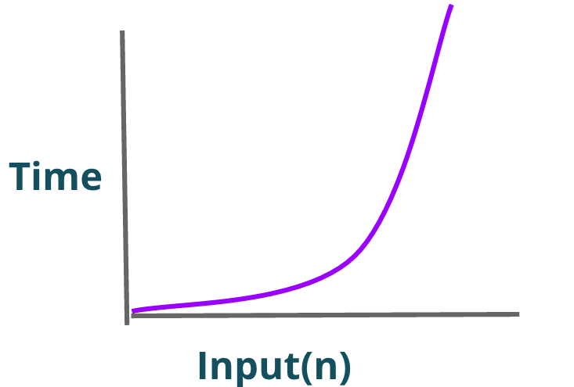
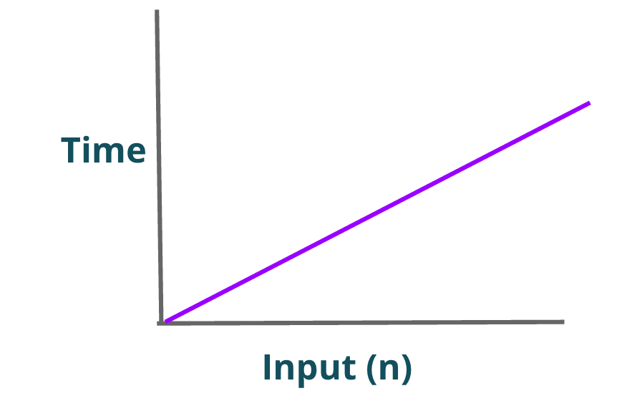
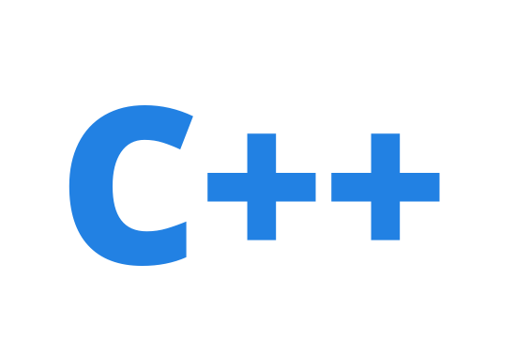

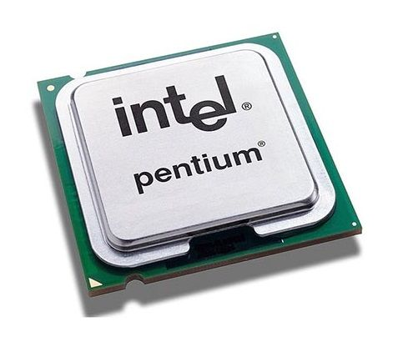
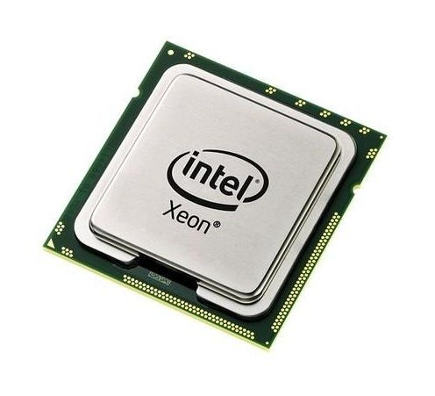
The Computing Stack- Why It Matters?
Faster
Application
Algorithm
Program
ISA
VS
𝞵architecture
Circuits
Electrons
Full-stack Solutions are the key!

Slide 3
Abstractions & Transformations: Key To Computing
Application
Q Application
Math, Quantum Information Theory
Algorithm
Q Algorithm
Program
Q Program
ECE/CSE
[Software, Architecture, & Systems]
ISA
Q ISA
𝞵architecture
Q Ctrl 𝞵arch
Circuits
Q Circuits
Electrons
Qubits
(atoms, ions)
Devices
We will focus on the software, architecture, and systems aspect of quantum computing

Slide 4
Quantum Bits (Qubits)
Classical machines encode information using classical bits
  Either 0 or 1 at any given time (only two points on the sphere)
A qubit is the fundamental unit of information on a quantum computer
  Any combination of 0 and 1 at the same time (any point on the sphere)
Quantum computers use qubits to encode information

Slide 5
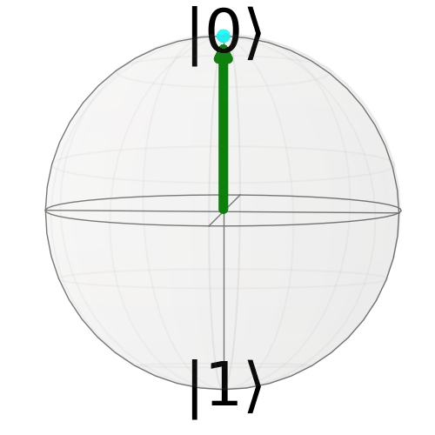
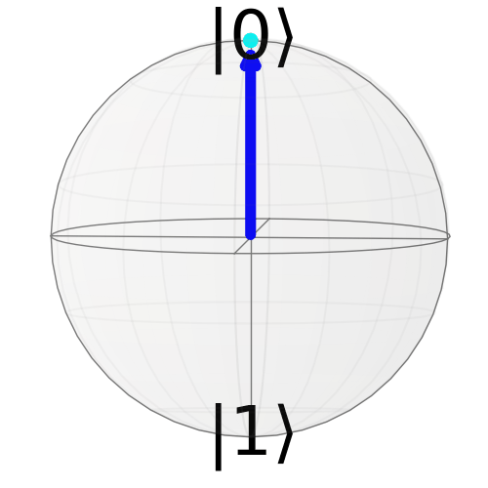
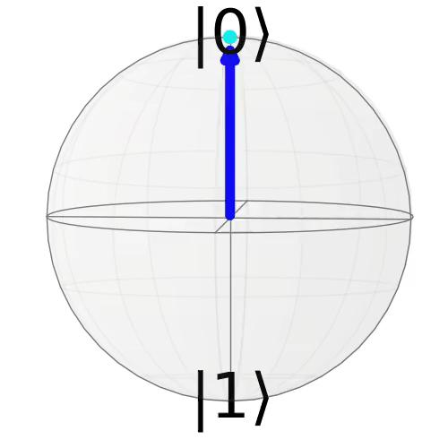
Superposition & Entanglement
A qubit exists in a superposition of 0 and 1.
  A quantum system with ‘n’ qubits exist in superposition of all possible 2^{n} states.
Entanglement enables us to create highly correlated states.
  This property allows us to efficiently manage the exponential state space.
Quantum computers use qubits to encode information

Slide 6
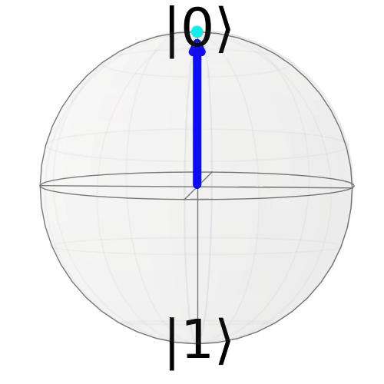
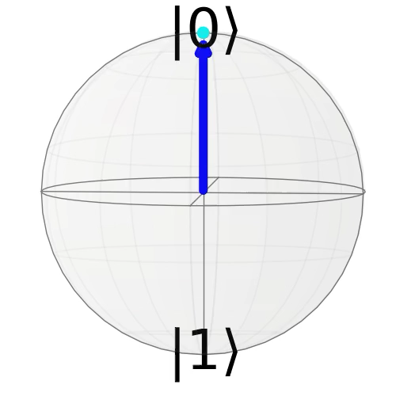
Quantum Gate Operations
Quantum gates manipulate the state of qubits
Single-qubit gates
X
X
Bit-flip/ NOT
Bit-flip/NOT
H
Superposition
Two-qubit gates
H
CNOT/ XOR
(Entanglement)
Superposition
+
Quantum gate operations rotate the qubits from one point to another

Slide 7
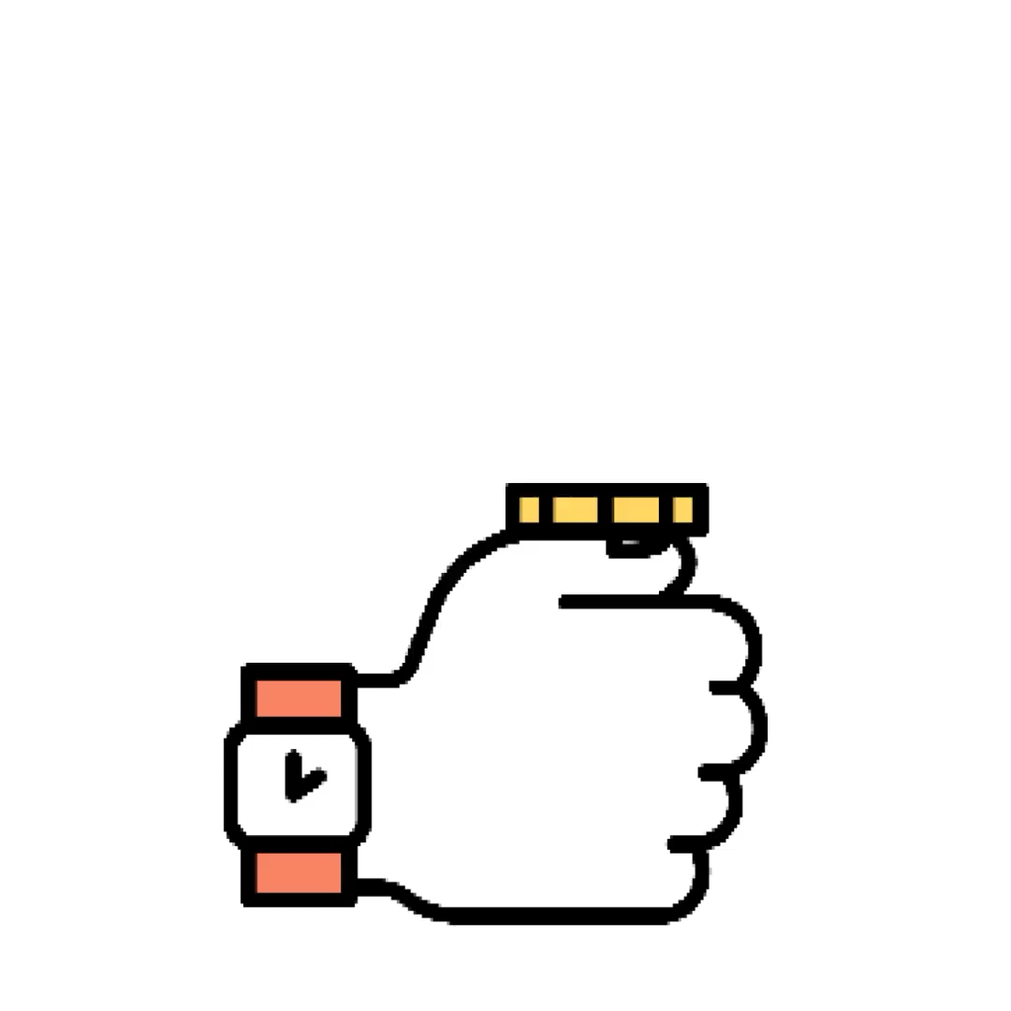
Quantum Programs
Quantum programs comprise of quantum operations
1
2
3
4
H
H
Bell pair circuit
q0
H
M
OR
Bell-pair or Entanglement pair
q1
+
M
T
T
1
2
3
Quantum programs manipulate qubits to amplify the probabilities of the correct output(s)

Slide 8
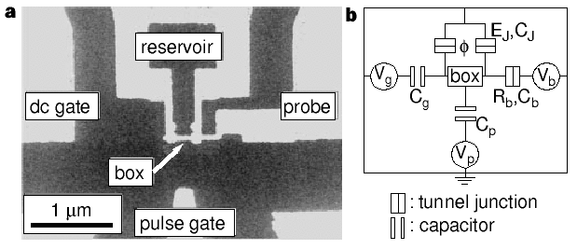
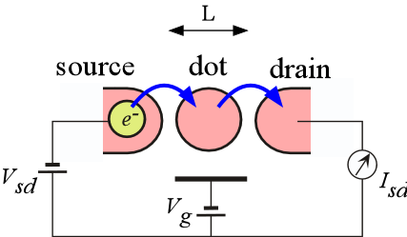
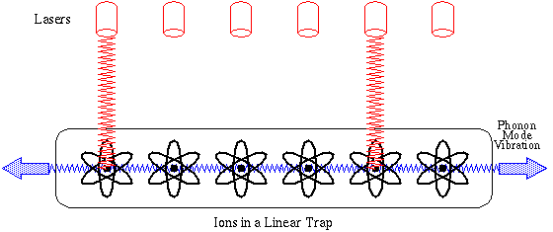
Qubit Candidate Technologies
A (physical) qubit can be any two-level system that can exist in any quantum superposition of two independent (physically distinguishable) quantum states
Ion-trap qubits
Superconducting qubits
Quantum-Dot qubits
And others: Photonic qubits, topological qubits, neutral atom qubits
Qubits are only a part of the quantum computing systems
Notes:
Trapped ions use ions as qubits and a trap that holds them in specific locations. They are controlled using a laser (or microwave)
and measured using photon detectors that detect the number of photons scatted during the readout operation.
Superconducting qubits are made up of Josephson junctions
that exhibit quantized energy levels when cooled to milli-Kelvin temperatures. Also known as artificial atoms, superconducting qubits are controlled using microwave signals.
Silicon spin/quantum dots are artificial atoms created by adding an electron to semiconductor materials (such as silicon atoms) and then the spin of the electron is controlled via microwave signals.

Slide 9
Quantum Computer: Organization
Host
Interface for access
Compilation
Output processing
Programs
Software
Control
Processor
Precise control to perform operations
Output
(Distribution)
Qubit
Devices
Quantum computer = Qubits + Classical Control Processor + Software

Slide 10
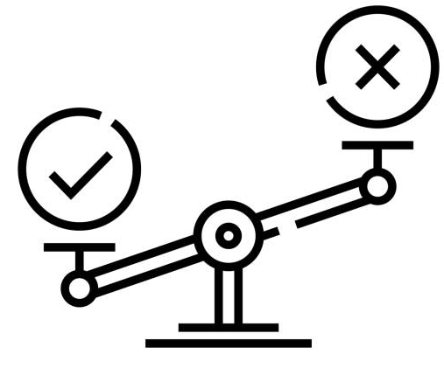
Key Challenge In Quantum Computing: Qubits Are Noisy
Qubit devices naturally lose their state even when left idle (decoherence)
Imperfect quantum operations lead to computational errors
Correct (70%)
Erroneous (30%)
Error
q0
H
M
q1
+
M
Gate errors ~1 %
Measurement/Readout errors ~1-4 %
~ 10- 100 microseconds
Classical bit error-rate ~10⁻¹⁸
Quantum hardware errors lead to incorrect outputs during program execution

Slide 11


Quantum Error Correction (QEC)
Many noisy physical qubits
Fault-tolerant logical qubit
Logical error rate < physical error rate
50-1000 physical qubits
-> 1 logical qubit
QEC code
QEC enables fault-tolerance but is expensive

Slide 12
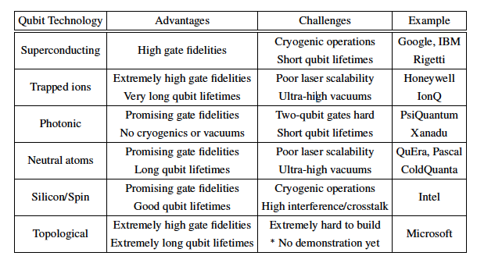
Evaluating Qubit Device Technologies
Two vectors: Qubit lifetimes and operational fidelities + Scalability
It is too early now to bet on a single qubit device technology

Slide 13
Available Quantum Systems + Future Roadmap
Objective is to scale up the systems while improving device error rates

Slide 14
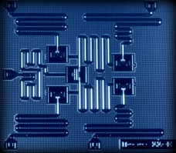
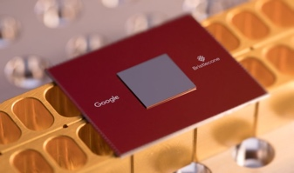
Noisy Intermediate Scale Quantum (NISQ)
Near-term quantum computers with few hundreds of qubits: NISQ machines
}
IBM
Condor
IBM
Kookaburra
Too small for QEC
at application level
Typical system sizes
(up-to 433 qubits)
2023
1,121 qubits
2025
4000+ qubits
Preskill, “Quantum Computing in the NISQ Era and beyond”, 2018
NISQ systems run programs in the presence of errors

Slide 15
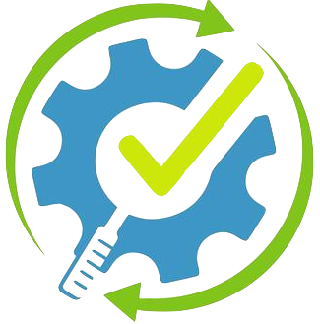

The Quantum Roadmap
Fault Tolerant Quantum
Error
Correction
Noisy Intermediate
Scale Quantum (NISQ)
Error
Mitigation
Quantum computers must enable fault-tolerance in the long-run, NISQ-regime until then

Slide 16



NISQ Computing Model
Can infer solution
q0
X
M
q1
+
M
Compile
Run
Log
Outcome
01
00
Program
Quantum
Executable
Quantum
Device
11
11
11
Repeat N trials
Goal: Maximize probability of successful execution or trial (program success rate)

Slide 17


Fault-Tolerant Quantum Computing
QEC involves syndrome (parity) extraction and decoding to identify errors
Decoder
1
Instructions to generate syndrome
3
Correction
2
Syndrome
2
Send syndrome to decoder
01…….01
Control
Processor
Readout
Interface
Did an error occur?
1
Where did the error occur?
QEC
Instructions
What was the type of error?
Qubits
3
Send correction to control processor
FTQCs extract information about errors and corrects them in real-time

Slide 18

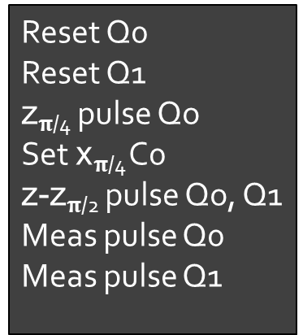
Key Role Of A Quantum Compiler
High Level Program
FPGA
Quantum_Func(2);
Quantum
Compiler
S
Higher Quantum Assembly
Lower Assembly
Q₀
Q₁
creg c[2] ;
qreg q[2]; //qubit variable
H q[0]; //equal superposition
CNOT q[0], q[1]; //entangle
MEAS (q,c); //measure
Reset Q0
Reset Q1
z$π$_{/4} pulse Qo
Set x$π$_{/4} C0
z-z$π$_{/2} pulse Qo, Q1
Meas pulse Q0
Meas pulse Q1
Q₀
//
Q₁
//
1
1
S
//
Controlled Gates: Bit-Flip versus Phase-Flip
//
Time
Quantum compilers transform high-level programs into low-level sequence of control pulses

Slide 19
NISQ Compilation Overview
Quantum
Program
Quantum
Circuit
Mapped
Circuit
Nativized
Circuit
Executable
Circuit
Generator
Qubit
Mapper
Assembler/Nativizer
Pulse
Scheduler
Quantum Compiler
Quantum compilers transform high-level programs into low-level sequence of control pulses

Slide 20
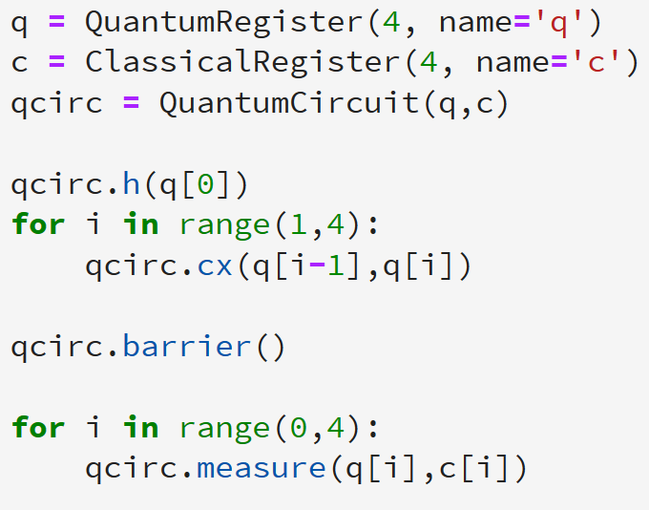
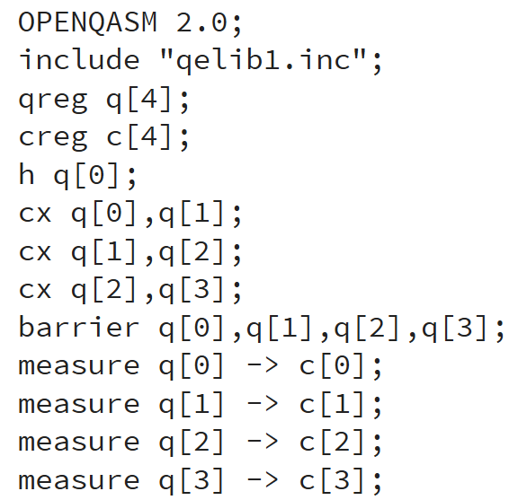
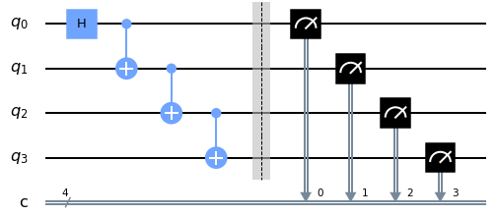
From Quantum Program To Quantum Circuit
Quantum Program
Quantum Circuit
Circuit
Generator
Classical and Quantum operations are used
Unrolled sequence of quantum operations
Controlled Gates: Bit-Flip versus Phase-Flip
The quantum circuit is often represented as a DAG to capture the data dependencies

Slide 21

From Quantum Circuit To Mapped Circuit
Qubit Allocation: Allocate each program qubit to a unique physical qubit
Qubit Routing: Introduce SWAPs to overcome limited device connectivity
Program
NISQ Device
Scheduled/Routed Program
SWAP
q0
q3
q2
q1
The scheduled and routed program is compatible with the topology of a device

Slide 22









From Mapped Circuit To Nativized Circuit
Gate Nativization: Translate each operation of the scheduled and routed program into a series of native gates that are specific to the device
Basis Gates/ Native Gates: The set of native gates supported by a device
Scheduled/Routed Program
q0
CNOT
H
q1
+
Gate Nativization
Gate Nativization
q0
R_{X}($\frac{Π}{2}$)
XY
R_{X}($\frac{Π}{2}$)
XY
RZ ($\frac{Π}{2}$)
RX ($\frac{Π}{2}$)
RZ ($\frac{Π}{2}$)
q1
R_{Z}($Π$)
R_{Z}($\frac{−Π}{2}$)
R_{X}($\frac{−Π}{2}$)
R_{X}($\frac{−Π}{2}$)
The nativized circuit is compatible with the basis gate set of a specific device

Slide 23
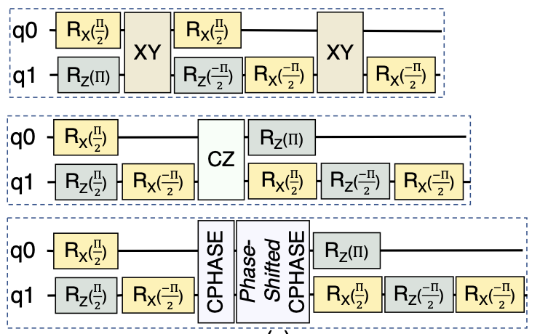
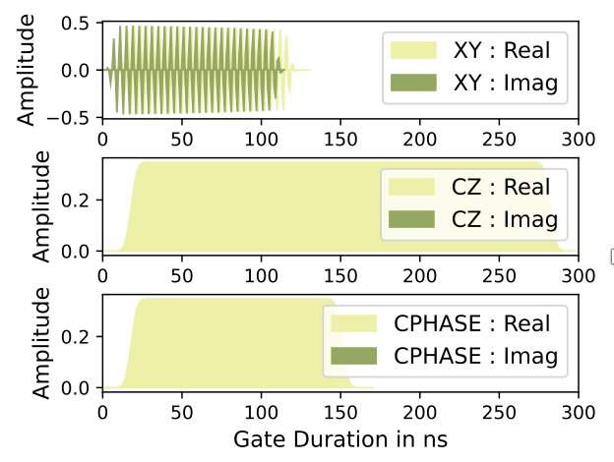
From Nativized Circuit To Pulse Schedule
Pulse Scheduling: Translate each native operation into its equivalent pulse schedule
The pulse schedule is loaded onto FPGAs and used to generate the required waveforms

Slide 24
NISQ COMPUTING
Why quantum computing? What topics will be covered? What are the requirements and expected outcomes?

Slide 25


40%
20%
20%
20%
20%
20%
20%
20%
A
B
C
D
A
B
C
D
Where is the ACM India Quantum Summer School 2025 happening?
A. Solan
A. Solan
B. Kolkata
C. Bangalore
D. Delhi

Slide 26
NISQ Objective: Maximize Program Success Rate
Use minimum gates
Use commutative properties, re-order operations
Program
Optimal native gate decomposition
Efficient mapping to reduce SWAPs
Unroll loops/ Decompose multi-qubit operations
Cancel
Gates
Map
Qubits
Schedule + Route
Cancel
Gates
Nativize
Gates
Correct Readout Errors
Reduce SWAPs, select better-than-worst SWAPs
Another round of cancellations+ reordering
Generate Pulse Schedule
Run
Post-process
Optimize at pulse-level to reduce program length
Characterization Circuits OR Functionally identical copies
Cut and Stitch
Software compiler optimizations are crucial to improve the success-rate of NISQ applications

Slide 27
Qubit MaPPING AND ROUTING
Why quantum computing? What topics will be covered? What are the requirements and expected outcomes?

Slide 28
Why Is Device Connectivity Limited?
Connectivity: Requires ‘connecting’ two qubits using resonators
Impractical
Real devices have limited connectivity
IBMQ-Tokyo
Google Sycamore
IBMQ-Toronto
Rigetti Aspen
Device connectivity depends on the qubit topology

Slide 29
Qubit Routing
Key Objective: Minimize #SWAPs required to relocate a qubit from one point to another
SWAP Overheads: Increase in total number of two-qubit operations and circuit depth
Google Sycamore
3x
2x
Max-Cut beyond 17 qubits
SWAPs increase the overall gate count and depth of programs thereby, reducing fidelity

Slide 30
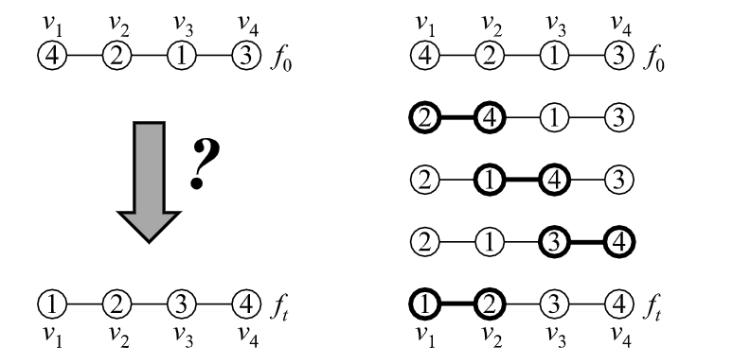
Minimizing SWAPs As A Token Swapping Problem
Given a graph G with nodes V_{i} and edges E_{ij}
Each node has a token that can only be exchanged via SWAP with the neighbor
Token configuration f₀ denotes the initial condition or arrangement of tokens
Find the minimum number of SWAPs to transform one token configuration f₀ into another f_{t} after swapping in t steps
Token swapping may be used to formulate the transformation of one qubit mapping to another

Slide 31
Implementation Example
Split program into independent layers
Transform (if required) the qubit mapping of i^{th} layer into (i+1)^{th} layer using SWAPs
Initial Qubit Allocation
L1
L2
L3
L1
cnot A,B
cnot C,D
cnot A,C
cnot A,D
A
S12
S23
B
D
B
L2
C
A
C
C
L3
A
D
SWAP minimization is NP-hard

Slide 32
Multiple SWAP Candidates
L1
cnot A,B
cnot C,D
cnot A,C
cnot A,D
B
D
B
D
C
B
D
A
B
D
D
B
L2
A
C
C
A
A
A
B
C
A
D
C
C
L3
SWAP A,C
SWAP A,B
SWAP C,D
SWAP B,D
A* search to locate candidates
Search complexity scales rapidly
Large memory footprint to store the A* search tree
A* search is not scalable

Slide 33
Lookahead Scheme
L1
cnot A,B
cnot C,D
cnot A,C
cnot A,D
cnot A,B
B
D
B
D
C
B
D
A
B
D
D
B
L2
A
C
C
A
A
A
B
C
A
D
C
C
L3
L4
SWAP A,C
SWAP A,B
SWAP C,D
SWAP B,D
SWAP insertion updates qubit mapping that impacts future operation scheduling
Choose the third SWAP candidate over the first one (CNOTs in layer L4 does not require any additional SWAPs in that case)
How far should you lookahead? What are the trade-offs?

Slide 34
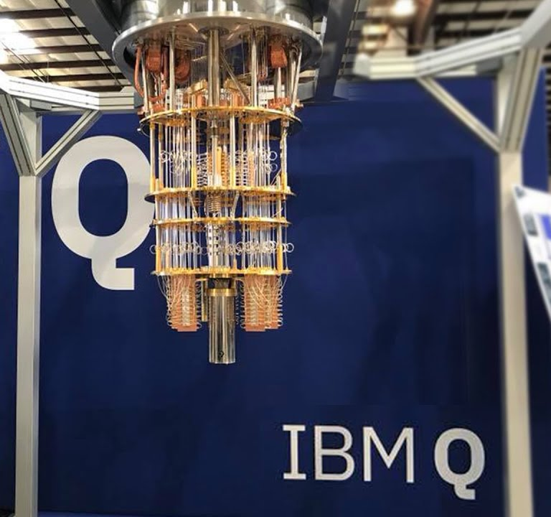
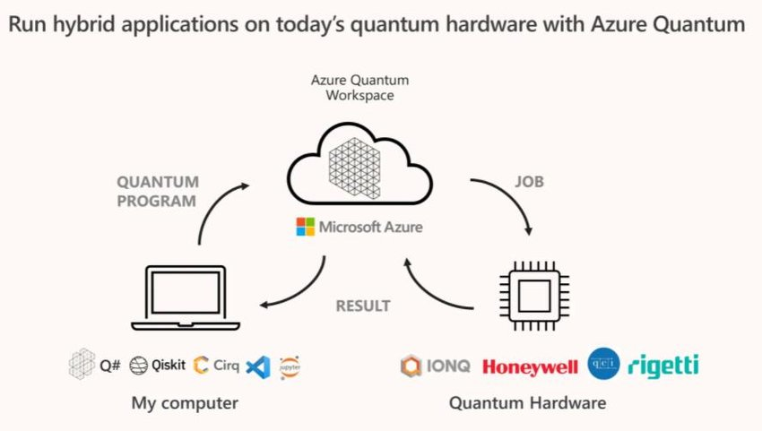
Quantum Then vs. Now: A Systems Approach
Quantum in 2016
Quantum in 2025
How to program a 5-qubit quantum computer?
What do we need to run a quantum application?
What does a basic quantum API look like?
How to manage classical - quantum interactions?
How can software mask hardware errors?
How to manage hardware errors at scale?
What do we need to support QEC?
The constraints faced by the quantum software stack has evolved significantly in recent years

Slide 35

What’s The Central Theme Of The Systems Approach?
Quantum in 2025
Scalability
What do we need to run a quantum application?
Program 100-1000s of qubits
How to manage classical - quantum interactions?
Manage multiple quantum, classical systems
How to manage hardware errors at scale?
Suppress/ mitigate errors on many qubits
What do we need to support QEC?
Transition to many logical qubits
Hardware scaling (error rates and #qubits) must be accompanied with software scaling

Slide 36
Quantum Cloud Services: Key Metrics Of Success
No to maximum control
Maximize profit
Minimum cost
Lower resource management overheads (e.g. reduced downtimes for calibrations)
Quality of solutions
Maximize resource utilization
Reduced wait times
Improve QoS
Manage diverse systems
Own vs. Third-party machines
Good classical support for apps
Quantum cloud services must optimize across multiple vectors

Slide 37







Unified Software Stack For Diverse Quantum Eco-System
Runtime support for seamless access
Diverse users
Diverse applications
Device + application specific compilation
Diverse systems
Support for distributed computing
Support for QEC codes
Key: Modularity

Slide 38




Device + Application Specific Optimizations
Natural
language
Solve an optimization problem
FrozenQubits, Ayanzadeh et al., ASPLOS’22
Quantum
Software
Map to quantum algorithm
Elivagar, Anagolum et al., ASPLOS’23
Write program in high-level language
Varsaw, Dangwal et al., ASPLOS’23
(JigSaw for VQEs)
Compiler
Translate to low-level gates to control qubits
Noise-aware compilation, Tannu et al., Murali et al., ASPLOS’19
Quantum
Hardware
Qubits use quantum mechanical properties
JigSaw, Das et al., MICRO’21
Pulse scheduling, xtalk mitigation
Exposing hardware and application characteristics improve the performance of compilers

Slide 39
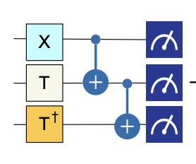
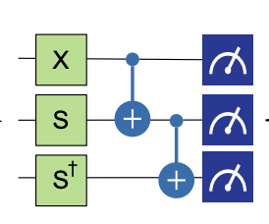
Even More Fine-grained Optimizations
Strategies that work for one qubit may be insufficient at application level
  Applying dynamical decoupling (DD) to all idle qubits at application-level is sub-optimal
Imitation Game, Das et al., HPCA’22
  What native gate to choose for translating high-level CNOTs?
Complex for fine-grained learning
Simpler for fine-grained learning
OPTRAN, CAFQA, etc.
  Selecting optimal subset of compiler passes, assisting VQE
ADAPT, Das et al., MICRO’21
  Only apply DD to qubits that benefit
Unsupervised learning assists in capturing fine-grained error characteristics

Slide 40

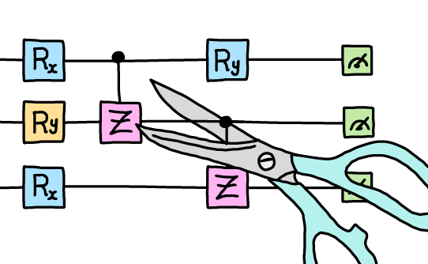

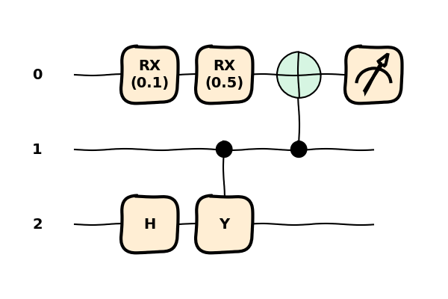
Trade-offs Exist
Compiler
Other areas?
Solvers
Circuit cutting
Complexity
Complexity
Heuristics
Circuit
IDEAL
IDEAL
Performance
Performance
MIDAS, Das et al., MICRO SRC’22
  Improved heuristics for SWAP insertion
FrozenQubits, Ayanzadeh et al., ASPLOS’23
  Application-aware cuts for QAOA
Quantum software solutions must appropriately navigate different trade-offs

Slide 41

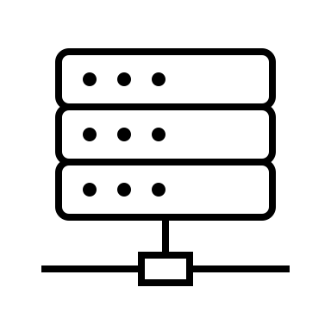
Support For Distributed Computing
…
Different QPUs
(error rates, qubit types, sizes)
Which QPU(s) should we use?
Different classical resources
(FPGAs, HPC clusters, GPUs)
…
How to minimize overheads?
  Compilation
  Post-processing
  Training
The goal is to parallelize and distribute the workload for end-to-end performance improvements

Slide 42
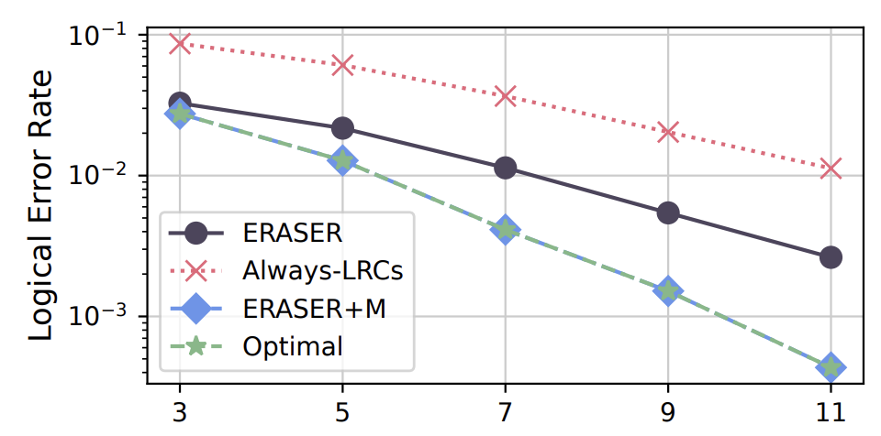
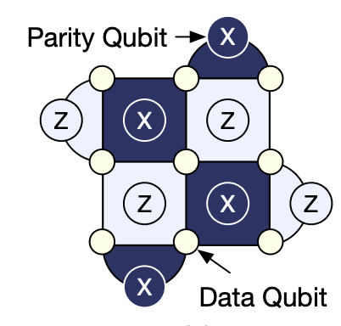
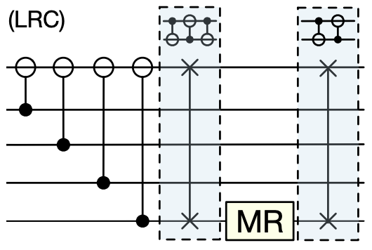
Support For Quantum Error Correction
QEC needs substantial software support
  High-level programmability, scheduling 1000s of operations per cycle, efficient resource management (cloud operations)
  Re-use existing software solutions as much as possible → improved programmers’ productivity, ease of software development
ERASER, Vittal et al., MICRO’23
  Speculative and adaptive insertion of leakage reduction circuits
Quantum software solutions must also support QEC in the near-term and beyond

Slide 43
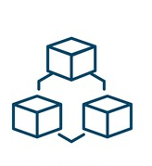

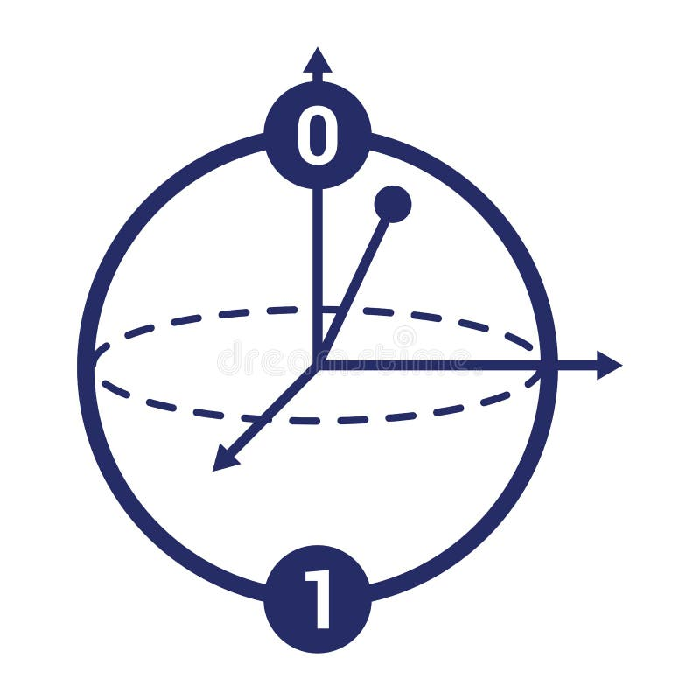


Final Thoughts About Quantum Software
Diversity
Modularity
Trade-offs
Full-stack approach

